Slide 1
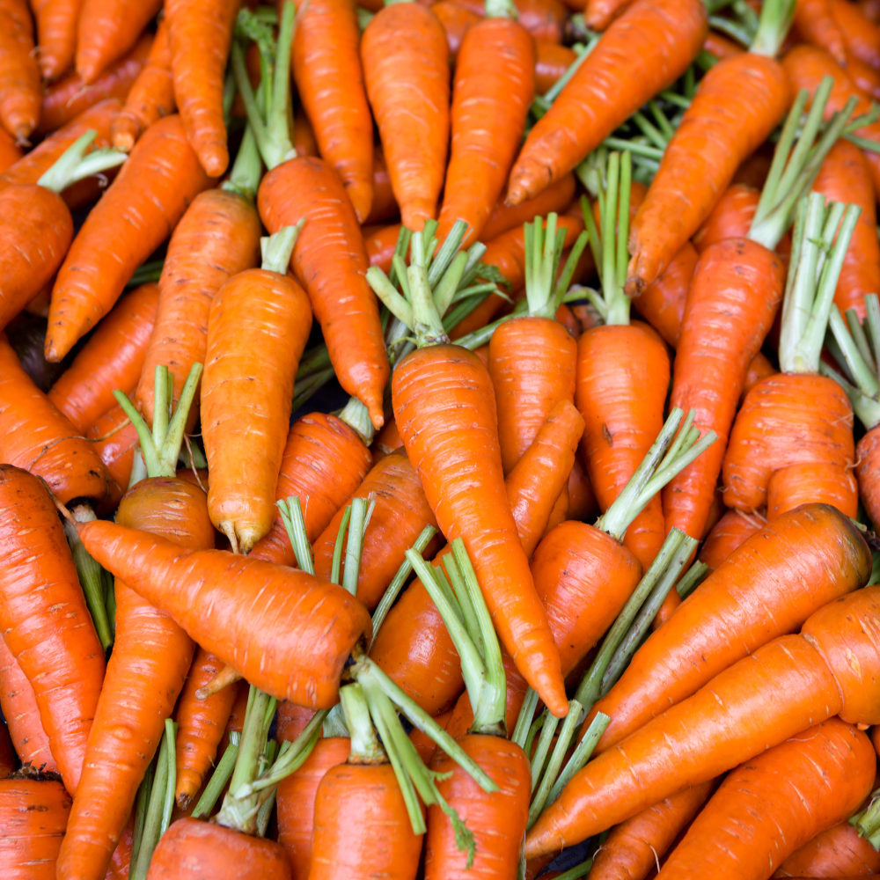
Advancing Data-Driven Solutions to Reduce Food Loss and Waste
The Environmental Impact of Food Waste
(And What You Can Do About It)
A Presentation to PEC
June 29, 2023
Minnie Ringland
Climate Analyst
Notes:
Note that data presented here reflects ReFED’s understanding of the food system as of 2021. Values may change as we release periodic updates to the data and models.

Slide 2
Our Mission
We’re a national nonprofit working to end food loss and waste across the food system by advancing data-driven solutions to the problem.
Our Vision
DATA & INSIGHTS
CAPITAL & INNOVATION
STAKEHOLDER ENGAGEMENT
We envision a sustainable, resilient, and inclusive food system that optimizes environmental resources, minimizes climate impacts, and makes the best use of the food we grow.
Leveraging data and insights to highlight supply chain inefficiencies and economic opportunities
Catalyzing capital to spur innovation and scale high-impact initiatives
Mobilizing and connecting supporters to take targeted action

Slide 3
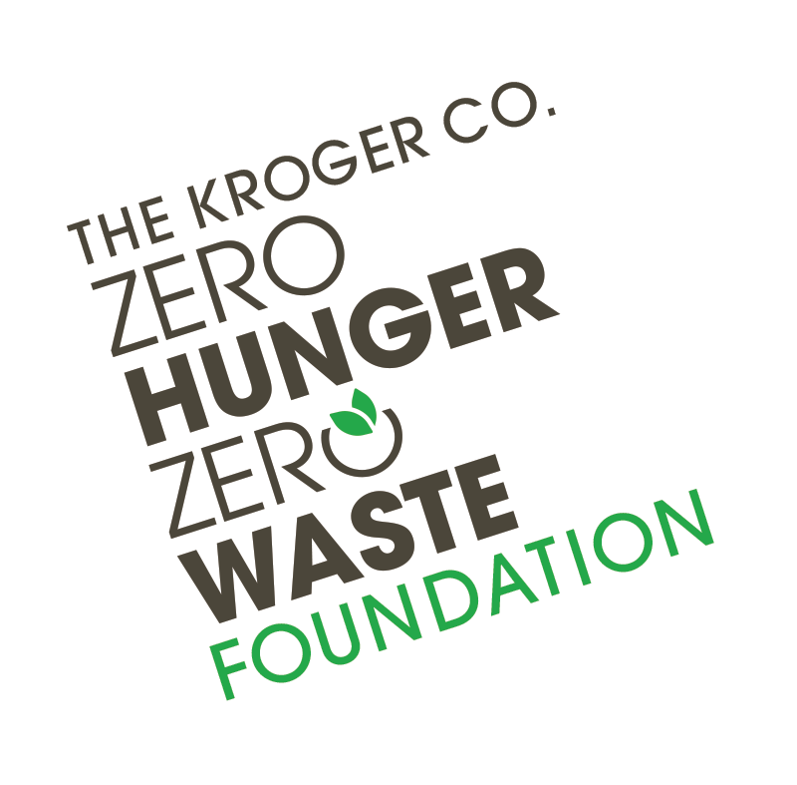
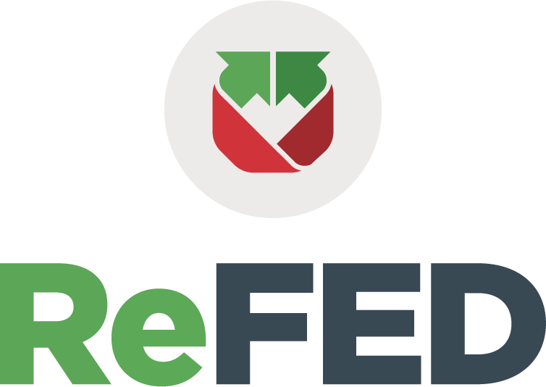
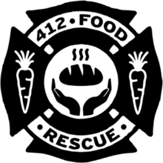
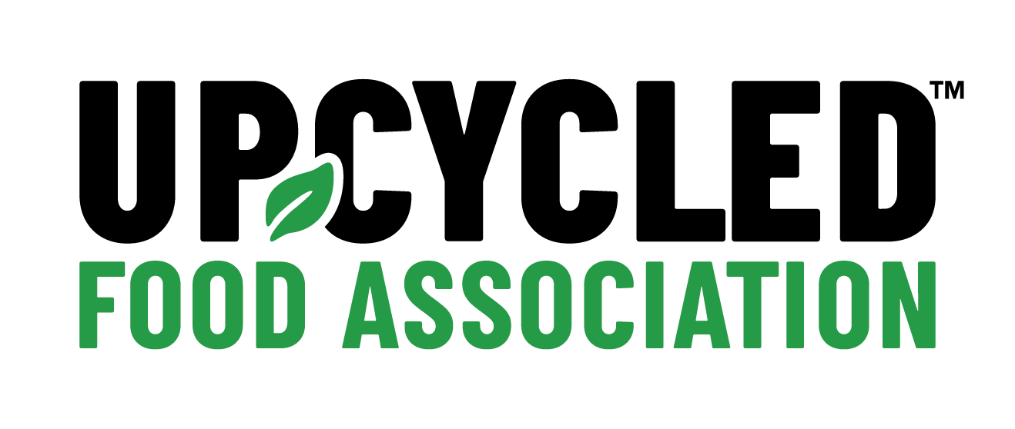
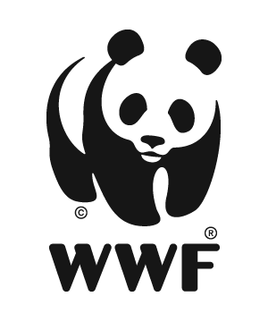
ReFED is the Epicenter of the Food Waste Ecosystem
GOVERNMENT
GOVERNMENT
FUNDERS
GOVERNMENT
FUNDERS
SOLUTION PROVIDERS
FUNDERS
SOLUTION PROVIDERS
FOOD INDUSTRY
SOLUTION
PROVIDERS
CORPORATE
CORPORATE
NGOS
RESEARCHERS
NGOs
RESEARCHERS
RESEARCH

Slide 4
Food Loss and Waste:
A(n) Problem
Climate Change
Environmental
Social
Economic
Sustainable Development

Slide 5
Global Food Waste
⅓
$1Tin value²
8%
of global
GHG emissions³
of all food produced¹
¹ FAO, Food Wastage Footprint & Climate Change, 2011
² FAO, 2014
¹ Mbow et al., 2019

Slide 6
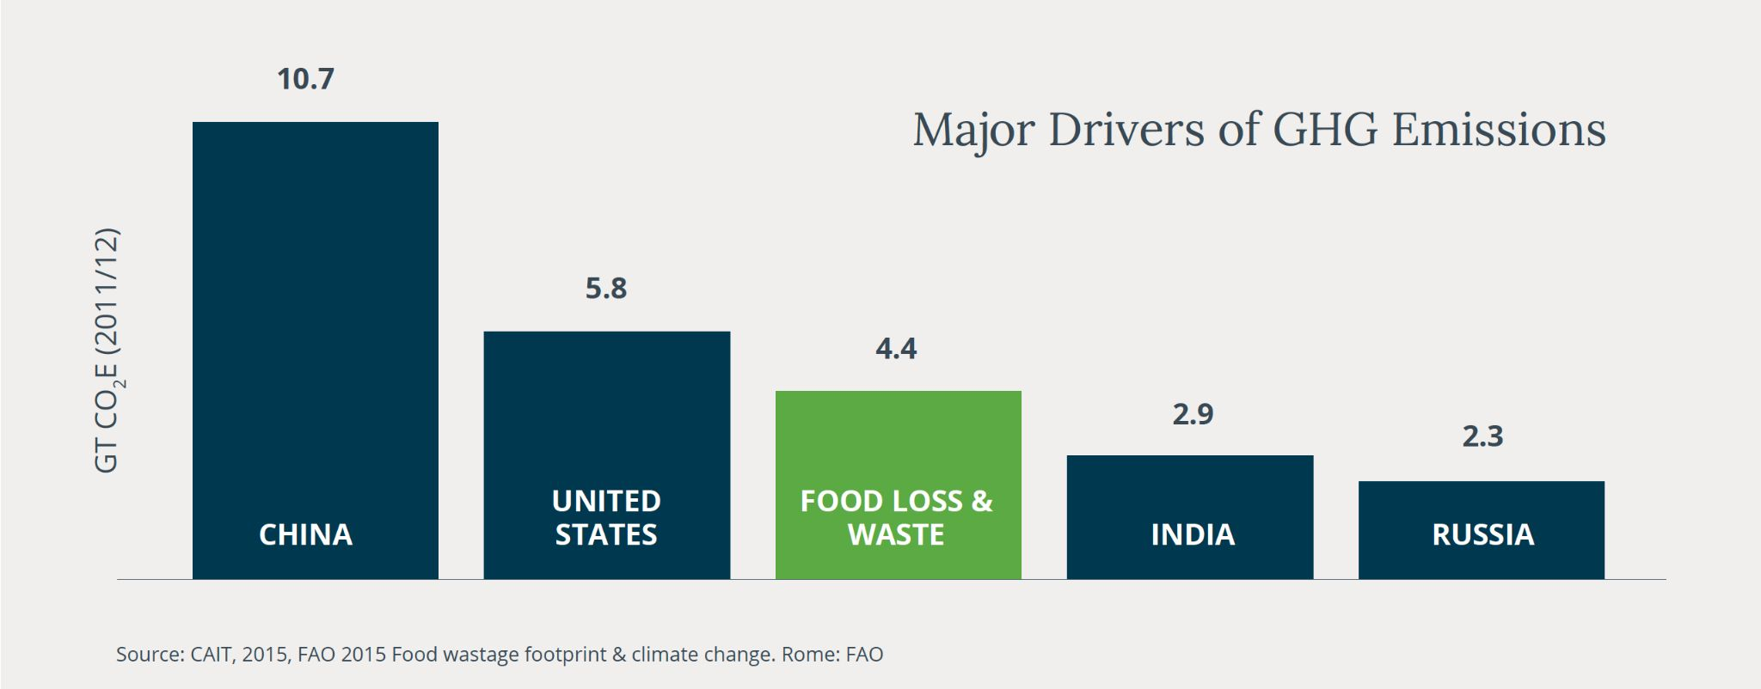
GHG Emissions by Country
If food waste were a country, it would be the third largest GHG emitter in the world.

Slide 7
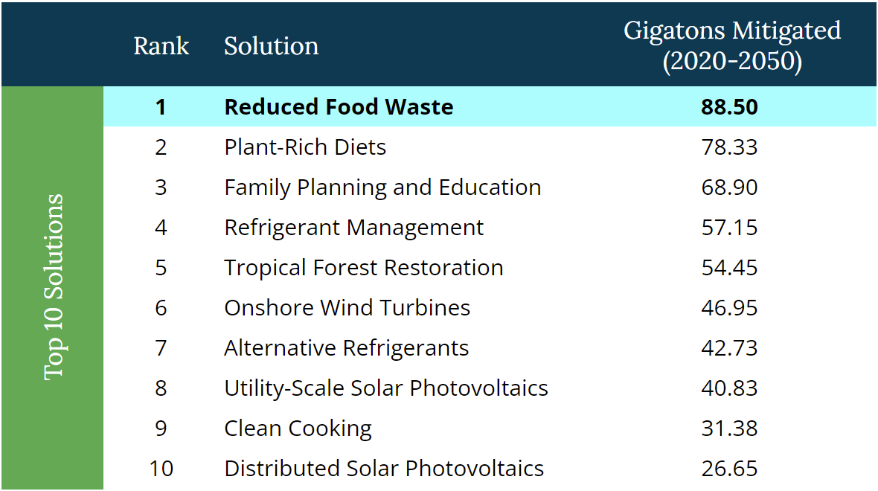
Food waste is STILL ranked #1 of 93 global solutions for reversing climate change globally by Project Drawdown.¹
¹ Scenario 1, Drawdown Solutions, 2022.
Notes:
https://drawdown.org/solutions

Slide 8
Feeding More People with Fewer Resources
50%
The United Nations predicts we’ll need to increase global food supply by this amount to feed the population in 2050...
Yet a new study is showing that agricultural productivity has decreased by this amount due to the impacts of climate change:
21%

Slide 9
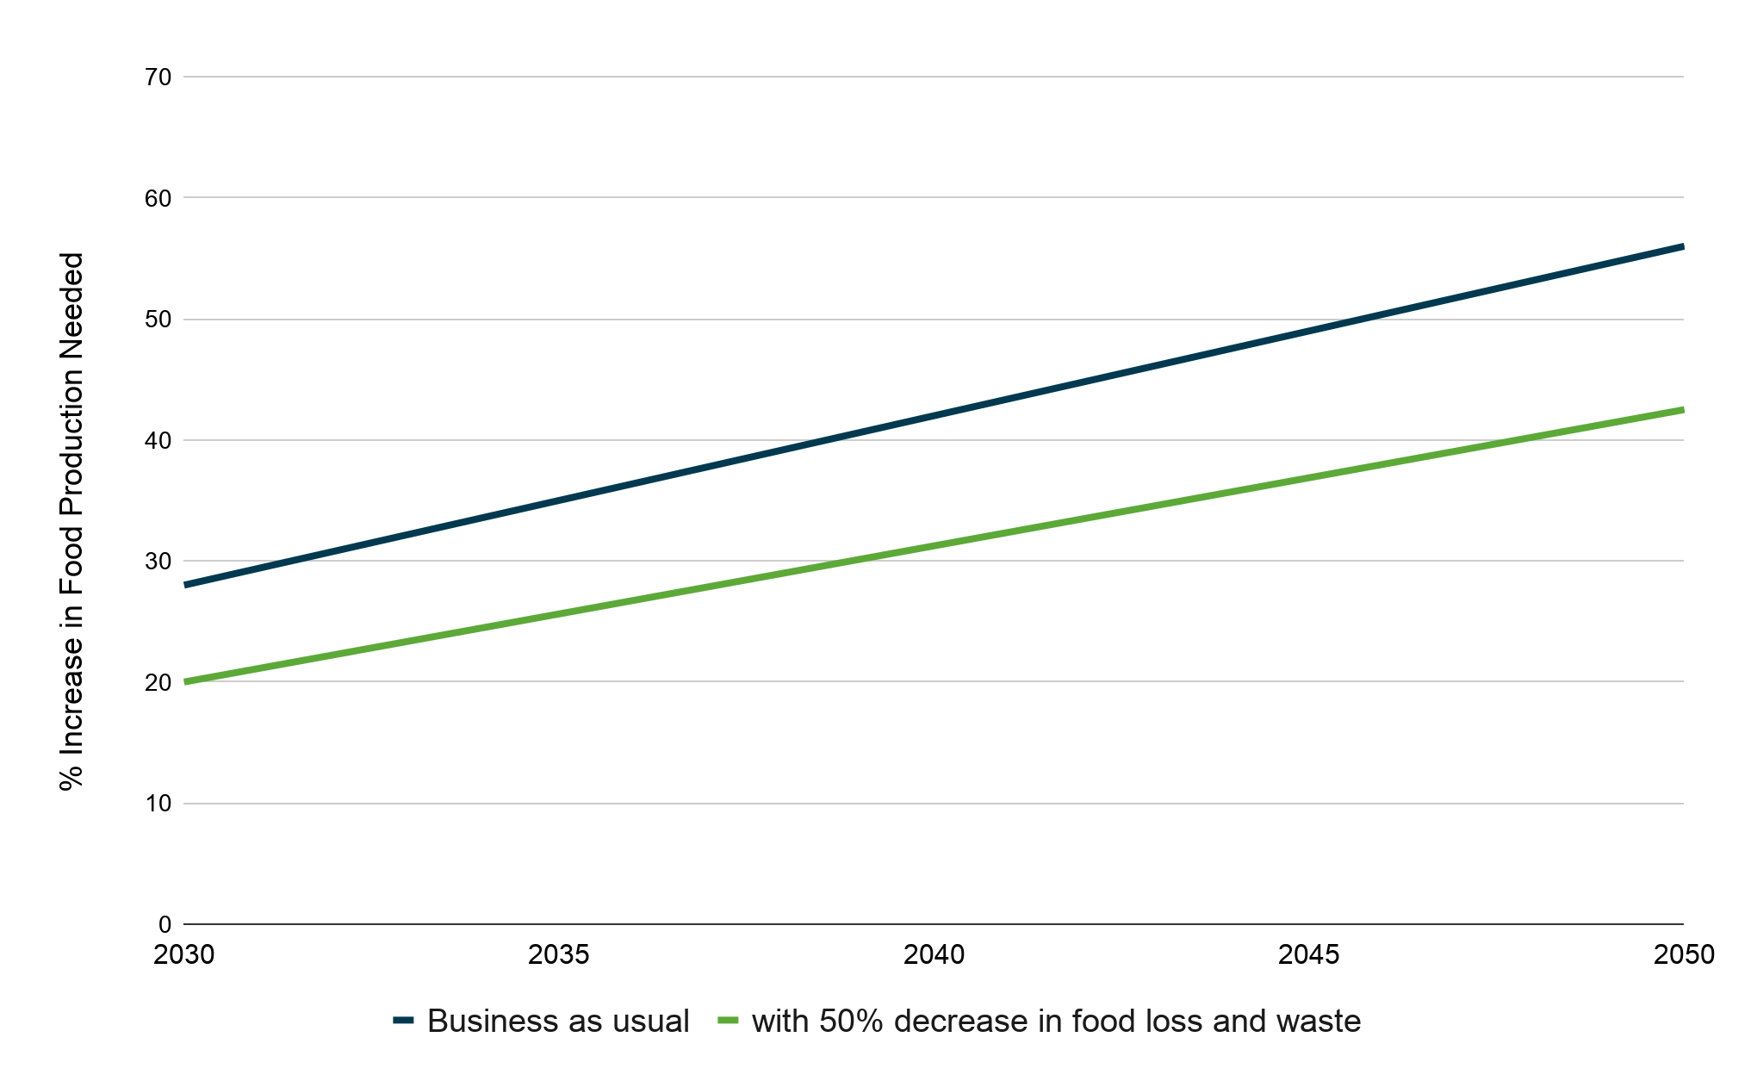
Feeding More People with Fewer Resources
Estimated
24% reduction in supply needed if food waste is
cut in half.
*We estimate that reducing food loss and waste by 50% globally would reduce the food calorie gap by 24%,
extrapolating from WRI, “Creating a Sustainable Food Future 2018.”

Slide 10
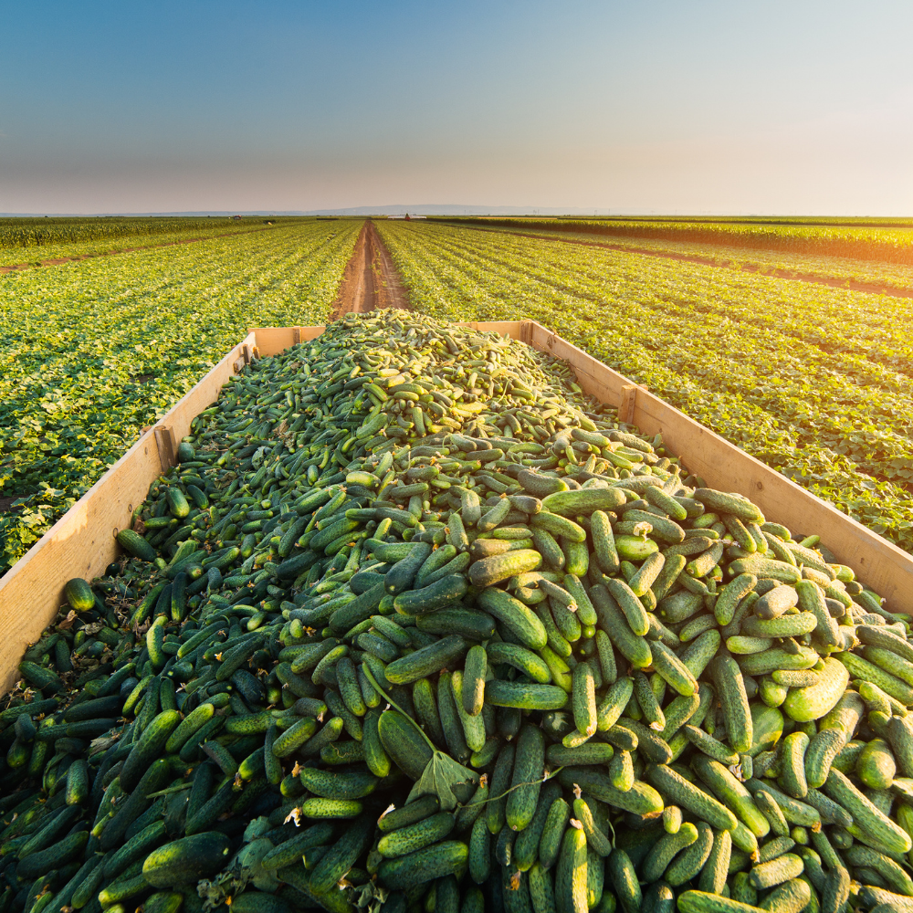
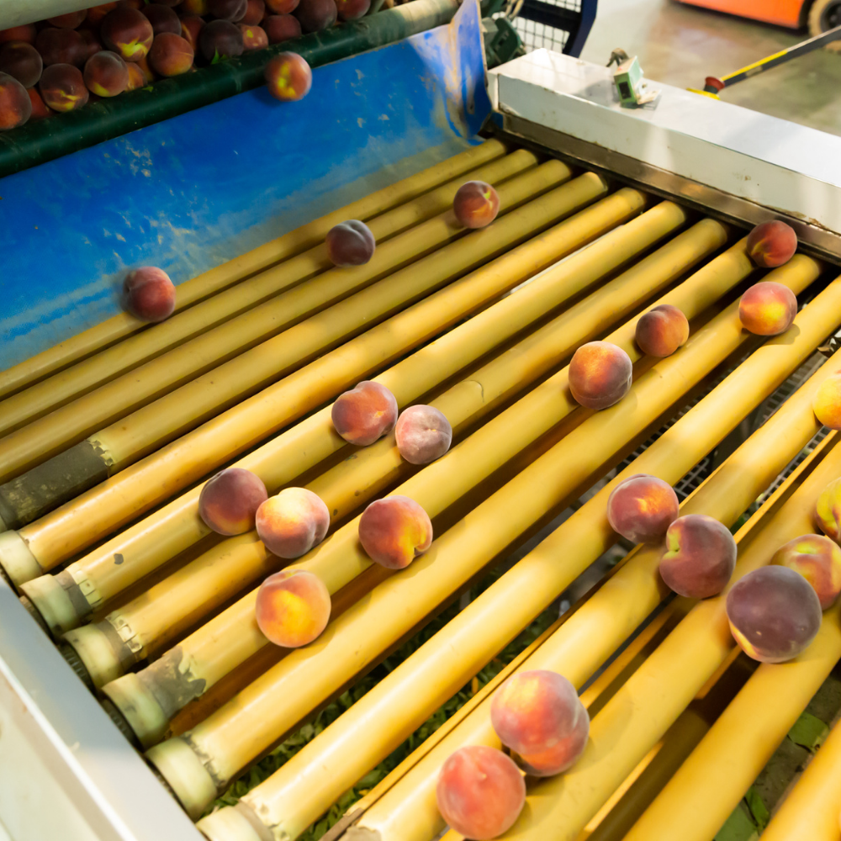
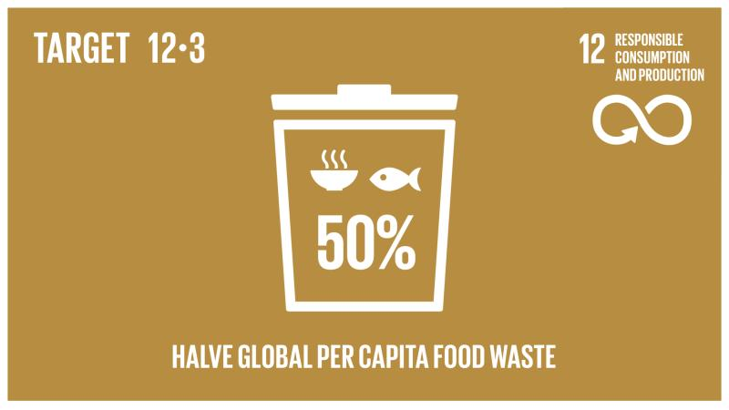
50%
National and international goal for the amount of food waste that must be reduced by the year 2030
Notes:
National and international goal for the amount of food waste that must be reduced by the year 2030

Slide 11
Environmental Impacts
of Food Loss and Waste

Slide 12
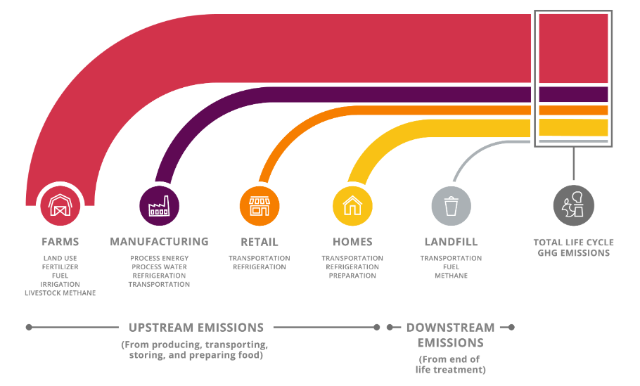
Food accumulates emissions as it moves along the value chain, and the relative contribution to life cycle emissions varies by sector

Slide 13
Here in the US…
38%
of all food went uneaten
in 2021
$444B
was spent in 2021 on food that was never eaten
Notes:
6% US Emissions = 84 million passenger vehicles, electrifying 74 million homes

Slide 14
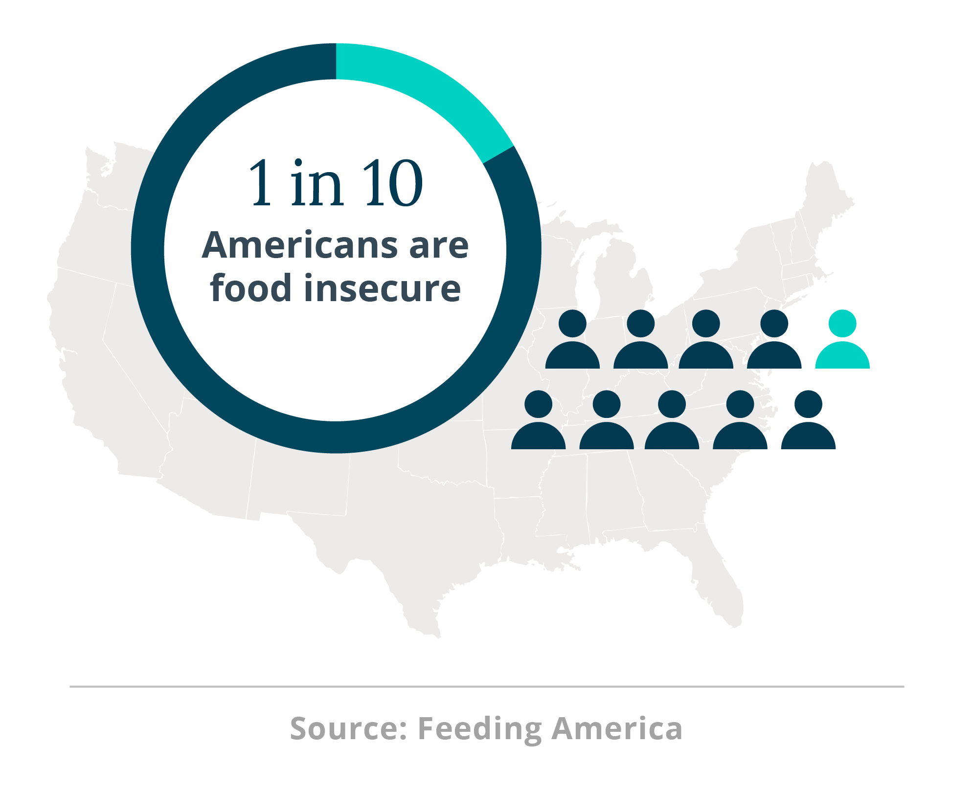

Slide 15
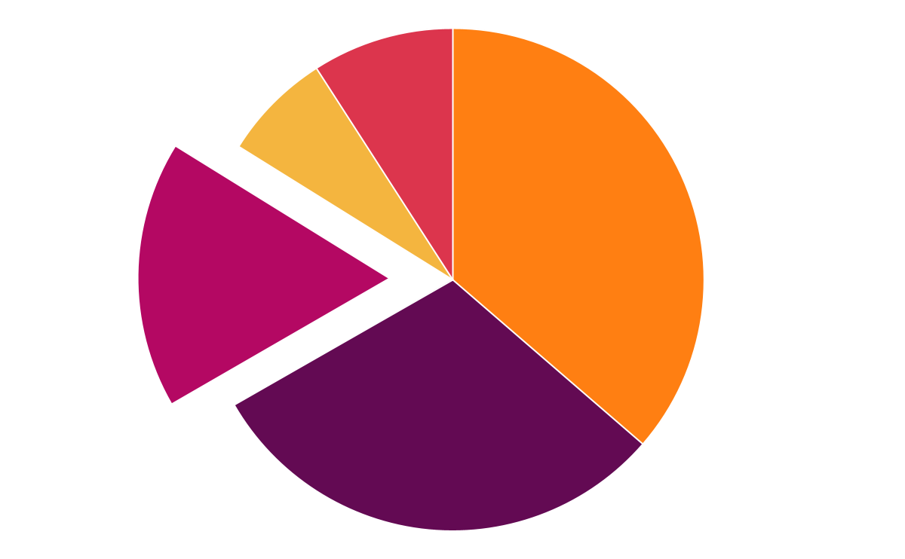
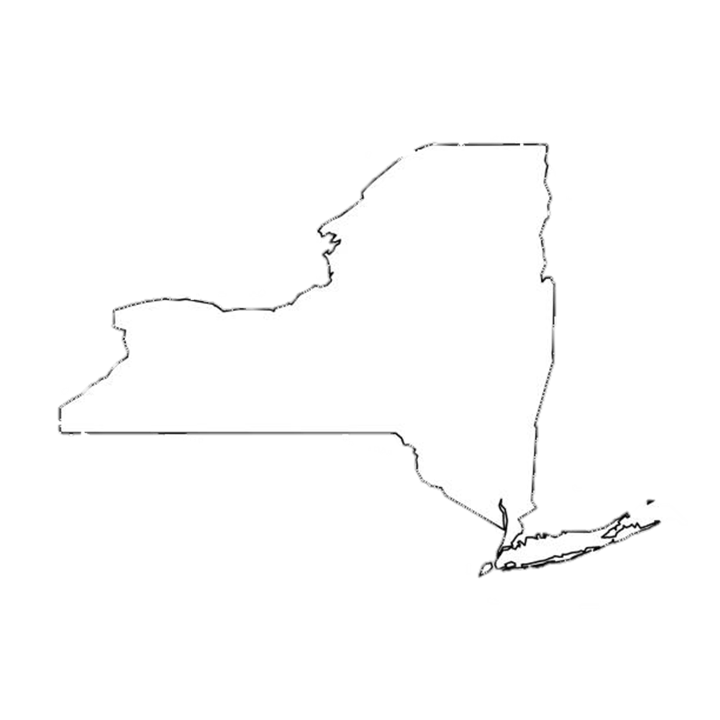
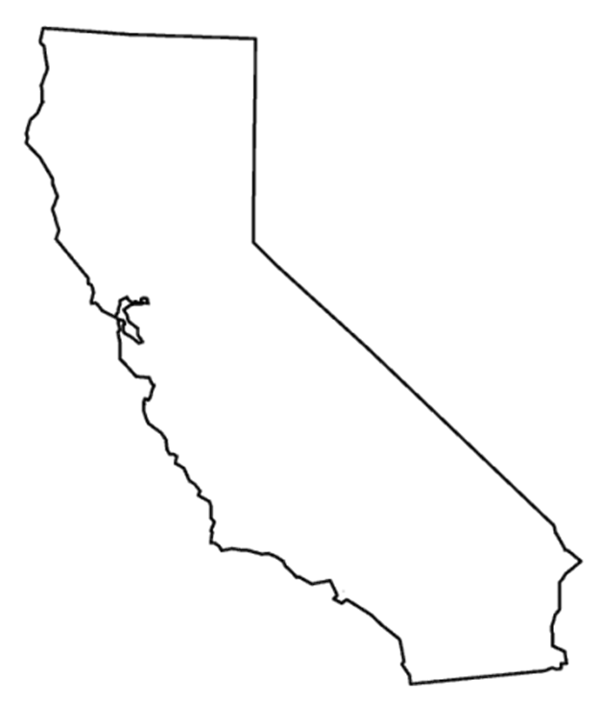
Addressing Food Waste Reduces Emissions in 3 Distinct Ways
Eliminates Landfill Methane
Avoids Upstream Emissions
Maximizes Land Use
Food is the #1 material in landfills (24% of incoming trash)
Landfills are the 3rd largest source of U.S. methane emissions. Experiments indicate that complete diversion of food waste from landfill would reduce methane generation potential by 33%.¹
93% of life cycle emissions are accumulated by the time food exits the home.²
Further emissions from production, transport, storage, and preparation of additional food are prevented if food is consumed rather than wasted.
The land used to grow food that ultimately is not eaten makes up 16% of U.S. agricultural land.³
This is an area the size of New York and California combined.
Coal
7%
Other
9%
Livestock
37%
Landfill
17%
Oil & Gas
30%
93%
1. Krause 2019
2. ReFED Insights Engine
3. Read et al. (2020) via EPA’s 2021 Farm to Kitchen Report

Slide 16
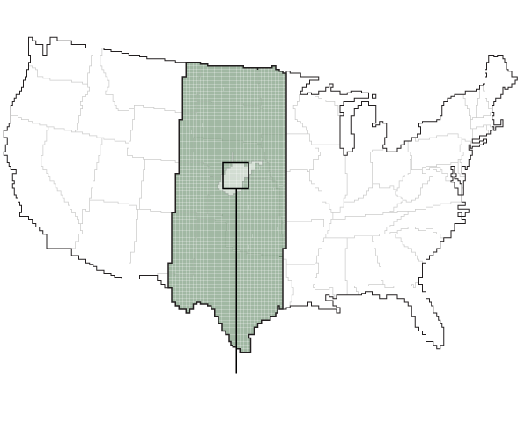
Impact of Reducing Food Waste by 50%
9%
Reduce Land Use by at least
(an area the size of Arizona)²
17%
Reduce Threats to Biodiversity¹ by
2.6 million acres of grassland were plowed up from 2018-2019, primarily to make way for row crop agriculture. This is an area larger than Yellowstone National Park. Restoring the full amount of carbon to croplands can take 350 years.⁴
11%
Reduce Water Use by ³
1. Read, Hondula, & Muth 2022
2. Read et al. (2020) via EPA’s 2021 Farm to Kitchen Report
3. Kummu et al. (2012) via EPA’s 2021 Farm to Kitchen Report
4. World Wildlife Fund, The Plowprint Report: 2021

Slide 17
Understanding
Food Loss and Waste

Slide 18
What is “Surplus Food”?
All food that goes unsold or unused by a business or that goes uneaten at home – including food and inedible parts (e.g., peels, pits, bones) that are fed to animals, repurposed to produce other products, composted, or anaerobically digested. It also includes food that is donated.
SURPLUS FOOD
RESCUE
RECYCLING
FOOD LOSS & WASTE
Food Donation
Animal Feed
Biomaterial/Processing
Co/anaerobic Digestion
Compost
Controlled
Combustion
Land
Application
Landfill
Refuse/
Discards
Sewer

Slide 19
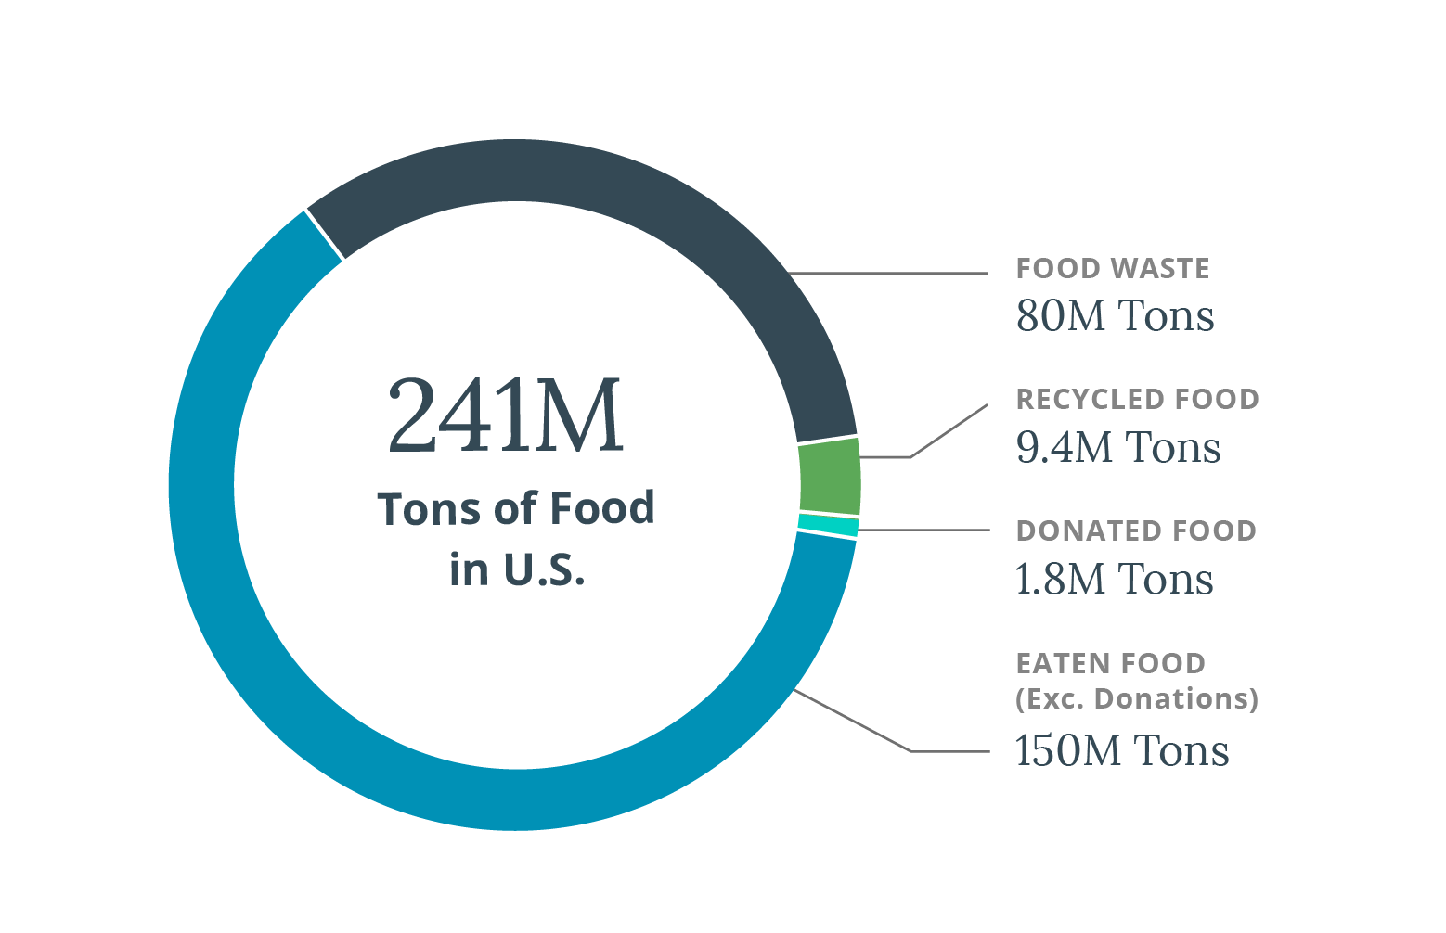
What’s happening to food in the U.S.?
Notes:
The U.S. generated 91 million tons of surplus food in 2021, which is 38% of total production.

Slide 20
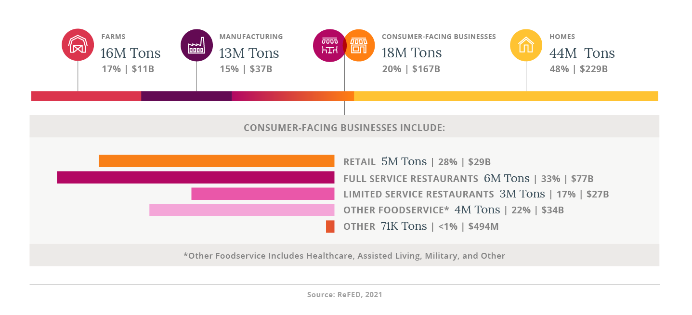
Surplus food occurs across the supply chain.
Notes:
Surplus food is often considered to be a singular problem, but it’s an entirely different situation for hundreds of tons of broccoli to go unharvested on a farm compared to a half-full platter of uneaten potatoes that’s scraped into the trash at home. Loss and waste occur at each stage of the supply chain, with the majority happening at consumer-facing businesses – including grocery stores, restaurants, and other businesses that sell and serve food – and in homes. Food waste is systemic in nature, and it’s important to recognize that what happens at one stage is often influenced by something that happens at another stage, either upstream or downstream. For example, that farm may not harvest all of its broccoli, because it doesn’t meet appearance specifications set by the retailers that purchase its produce – appearance standards the retailers established based on feedback received from the customers that shop in their stores.

Slide 21
More than half is edible.
Households are the largest contributor.
70% in restaurants is plate waste.
Notes:
Only 45% of farm surplus is “not fit for human consumption” - and only 19% is inedible parts (shells, peels, etc).

Slide 22
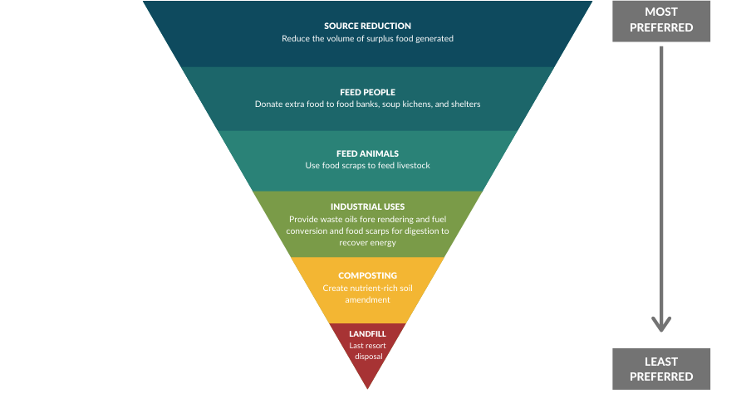
Reduce Reuse Recycle
Notes:
Top 10 Solutions for Key Impact Metrics

Slide 23
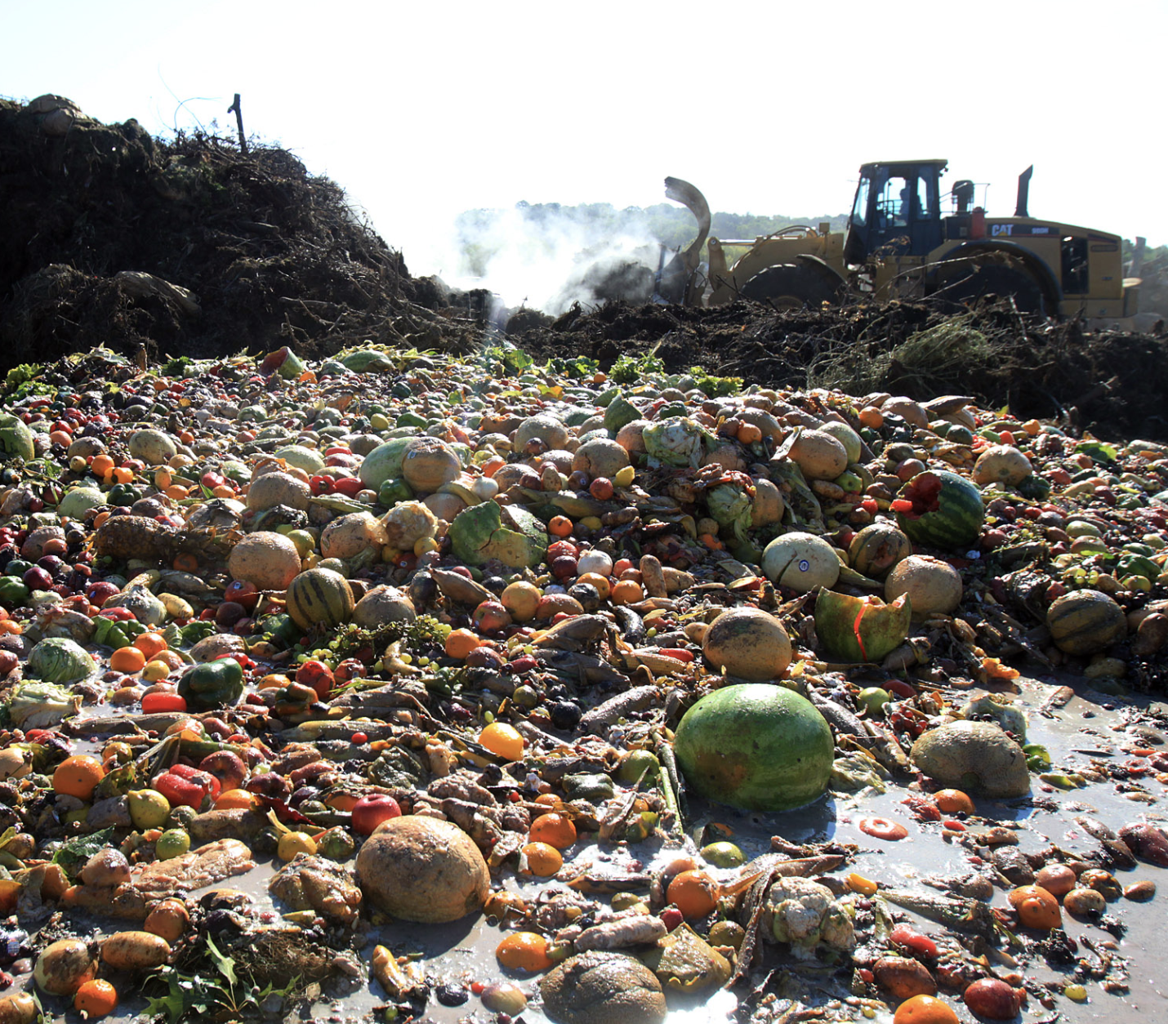
Barriers to Addressing Food Waste
Misalignment of costs and benefits
Low cost of food and disposal
Disaggregated supply and demand information and data gaps
Competing cultural priorities and expectations
Organizational silos
Low priority and capacity within food industry to monitor and make change
Notes:
The link to this is showing all of the ways food waste is impactful and the positive change that could occur with solutions

Slide 24
So…how are we doing?

Slide 25
Corporate and Municipal Commitments
2030 Champions (U.S.)
200+
COMPANIES
44+
COMPANIES
15
COMPANIES
16
CITIES

Slide 26
Actual Reductions
24%
19%
50%+
(SINCE 2020)
(SINCE 2017)
(SINCE 2017)

Slide 27
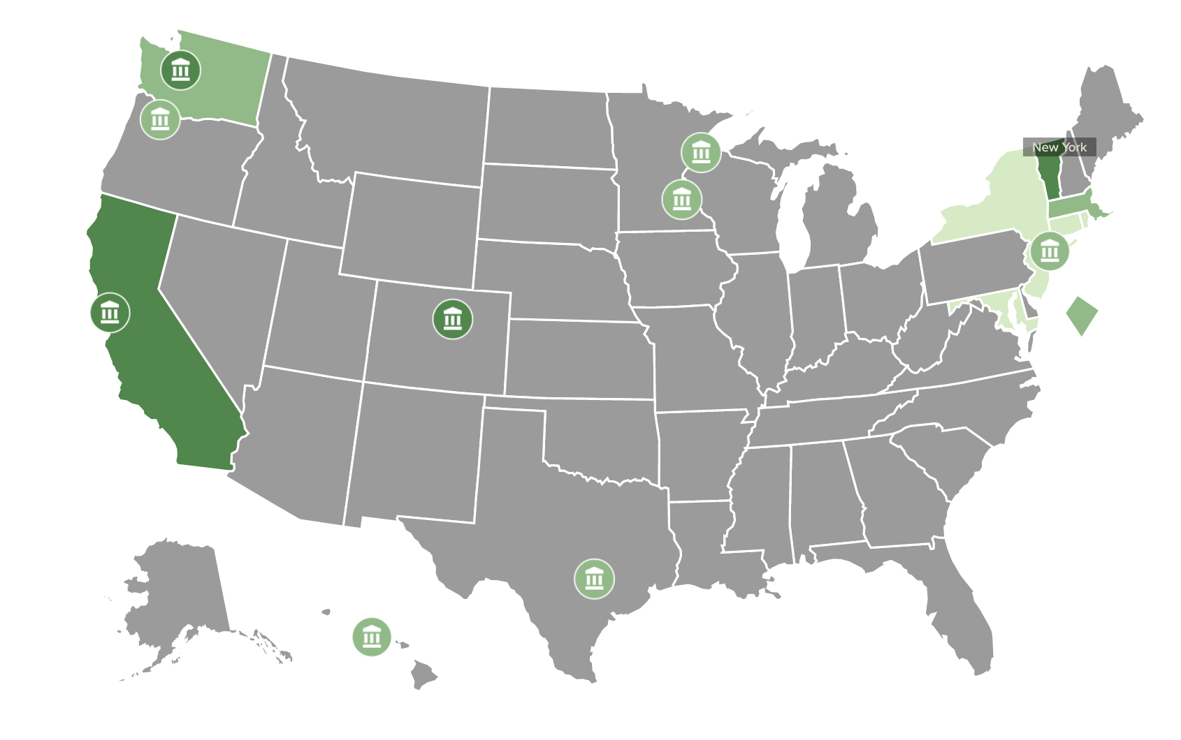
State Policy Action
99
Bills introduced
28
Bills passed

Slide 28
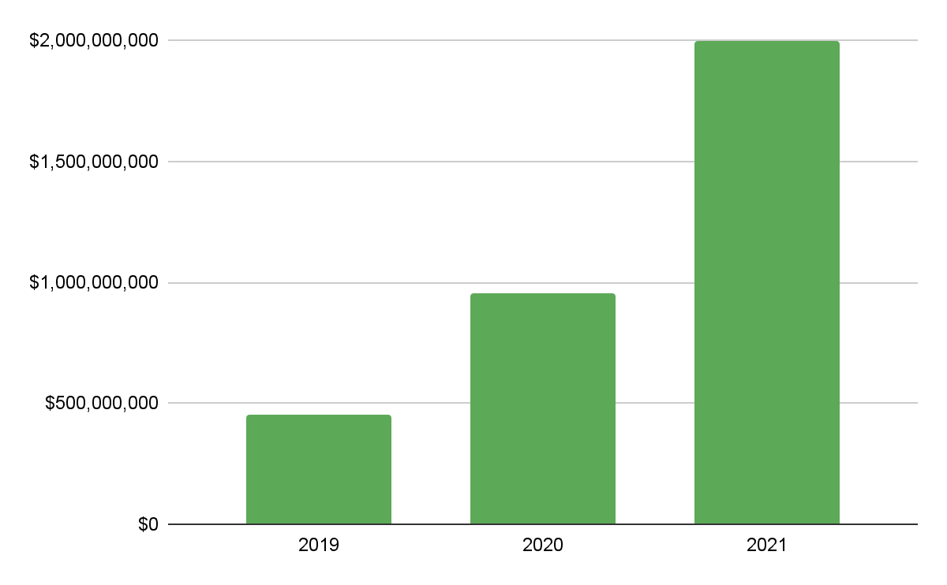
Huge uptick in private capital
$2B
~$1B
~$.5B

Slide 29
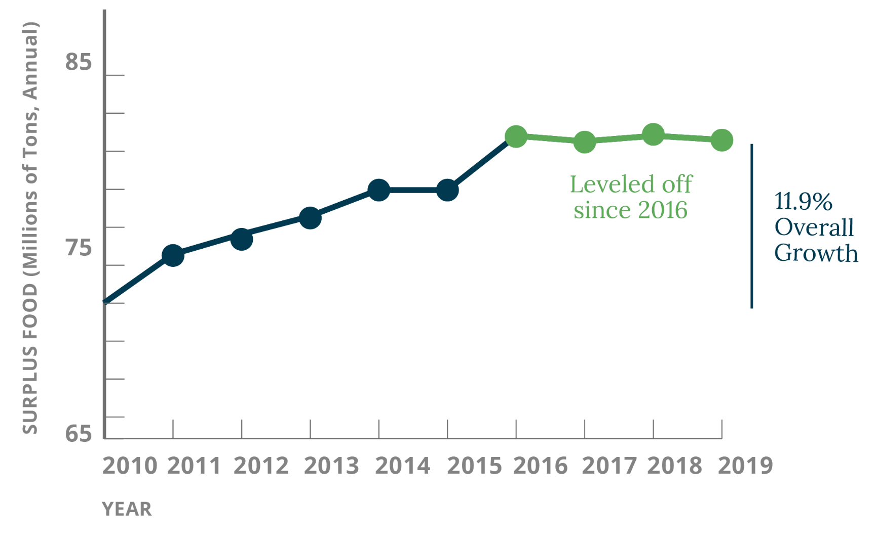
But we’re not reducing surplus food fast enough…
Notes:
After increasing nearly 12% in the first part of the last decade, the amount of surplus food - which is all food that went unsold or uneaten - actually leveled off starting in 2016…
Recent data indicates barely any change since 2019.

Slide 30
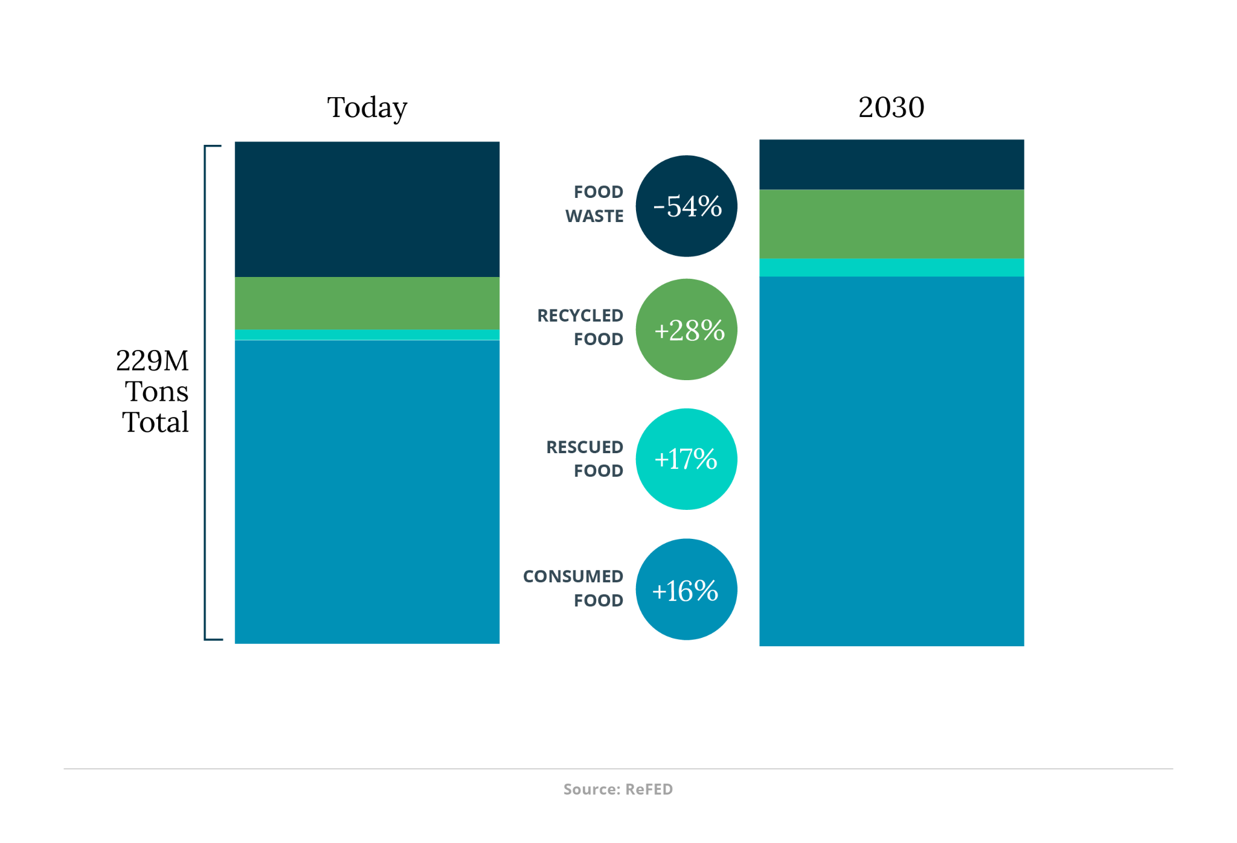
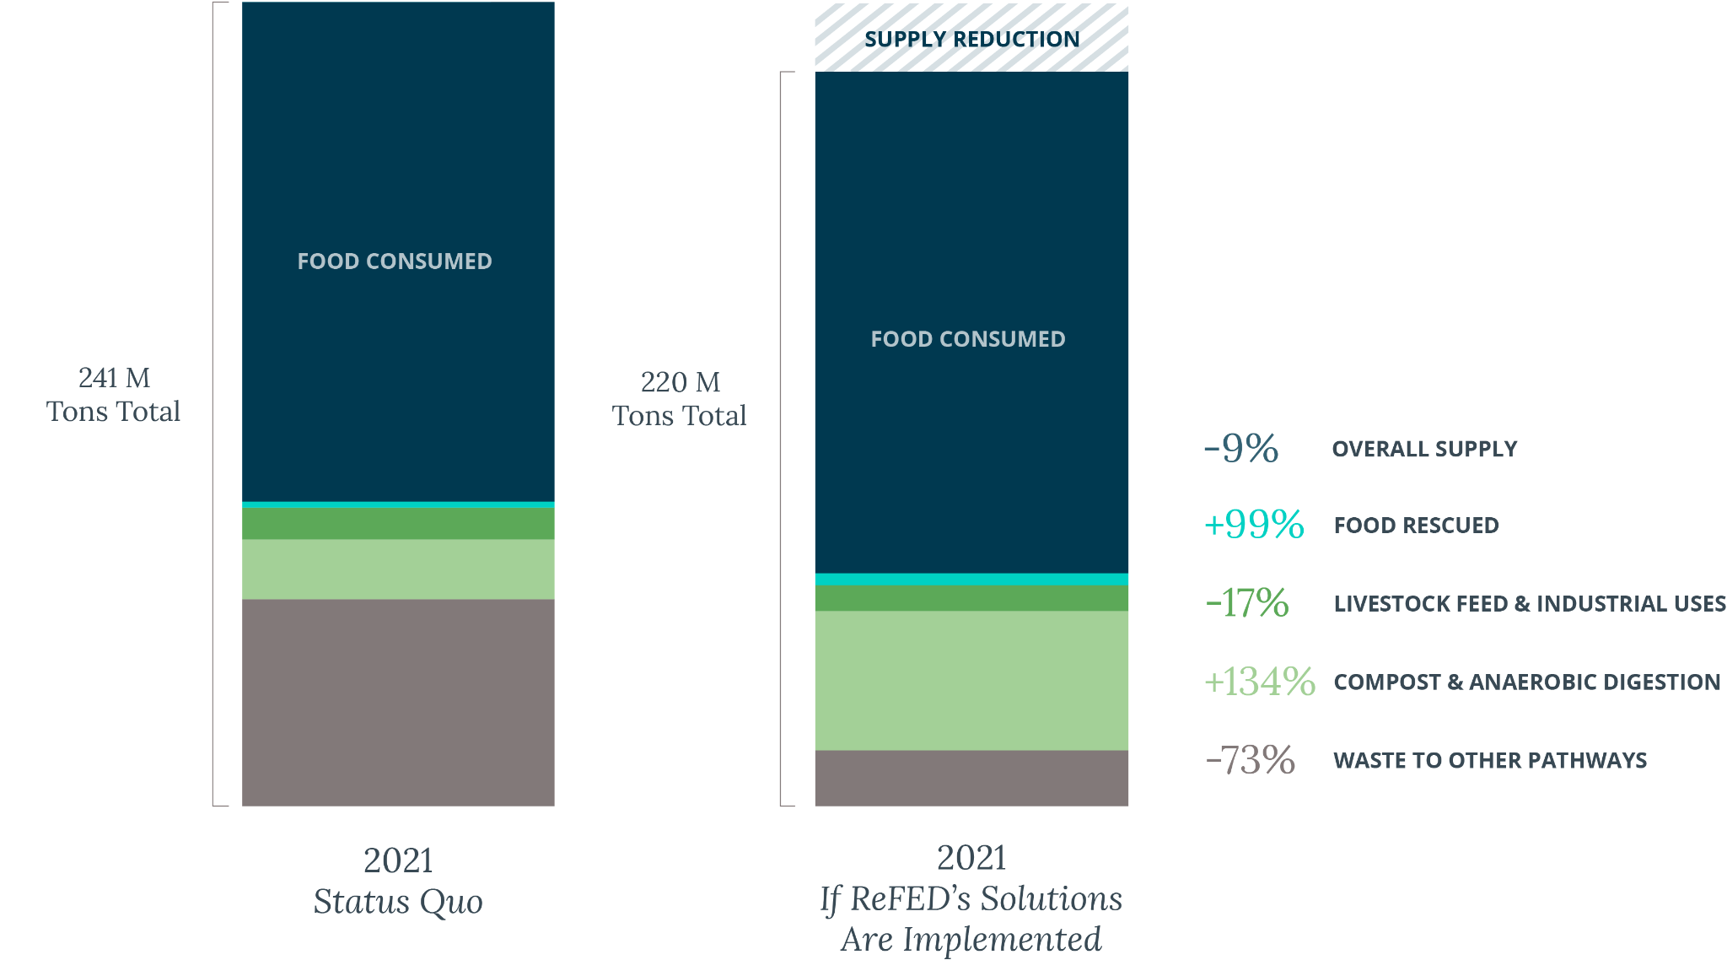
Post-Solutions
Supply Savings
Landill/combustion/Sewer
-83%
Composting/AD
Livestock feed/Industrial
190M
Tons Total
Notes:
What would that look like?

Slide 31
POP QUIZ!

Slide 32
About how many days
past the sell-by date
can you eat eggs?
a) None, that’s gross
b) 3-5
c) 10-20
d) 20-35

Slide 33
Let’s just say you weren’t
quite sure, so you put the egg
in a bowl of water. You know
it’s still good to eat if it:
a) Floats
b) Sinks

Slide 34
Let’s say it floated, so you toss it. How long of a shower (in minutes) could you have taken with the water it took to produce
that egg?
a) 5
b) 11
c) 25
d) 40

Slide 35
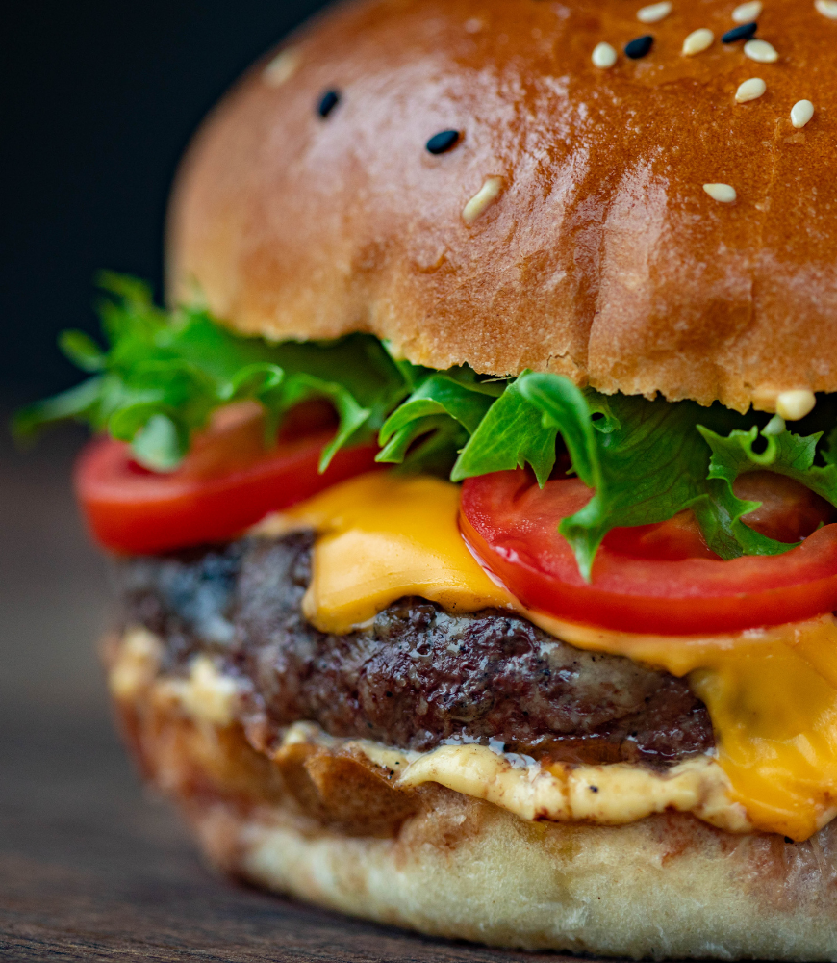
And what if instead of an egg, you threw out a hamburger – how many minutes of
showering then?
a) 20
b) 50
c) 75
d) 90

Slide 36
Let’s just say instead of one hamburger, you threw out all the turkey that gets thrown out over Thanksgiving. How many New York – San Francisco car trips would produce the same amount of GHG emissions?
a) 8,000
b) 80,000
c) 800,000
d) 8 million

Slide 37
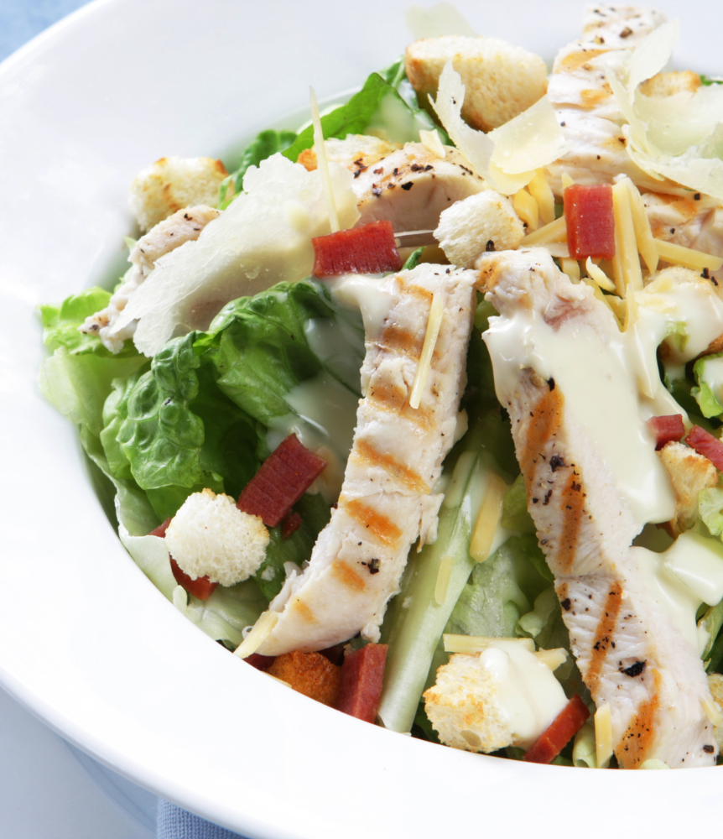
Now let’s talk about portions. Since 1980, obesity prevalence among children and the calories in a chicken Caesar salad have almost:
a) Doubled
b) Tripled
c) Quadrupled
d) Stayed the same

Slide 38
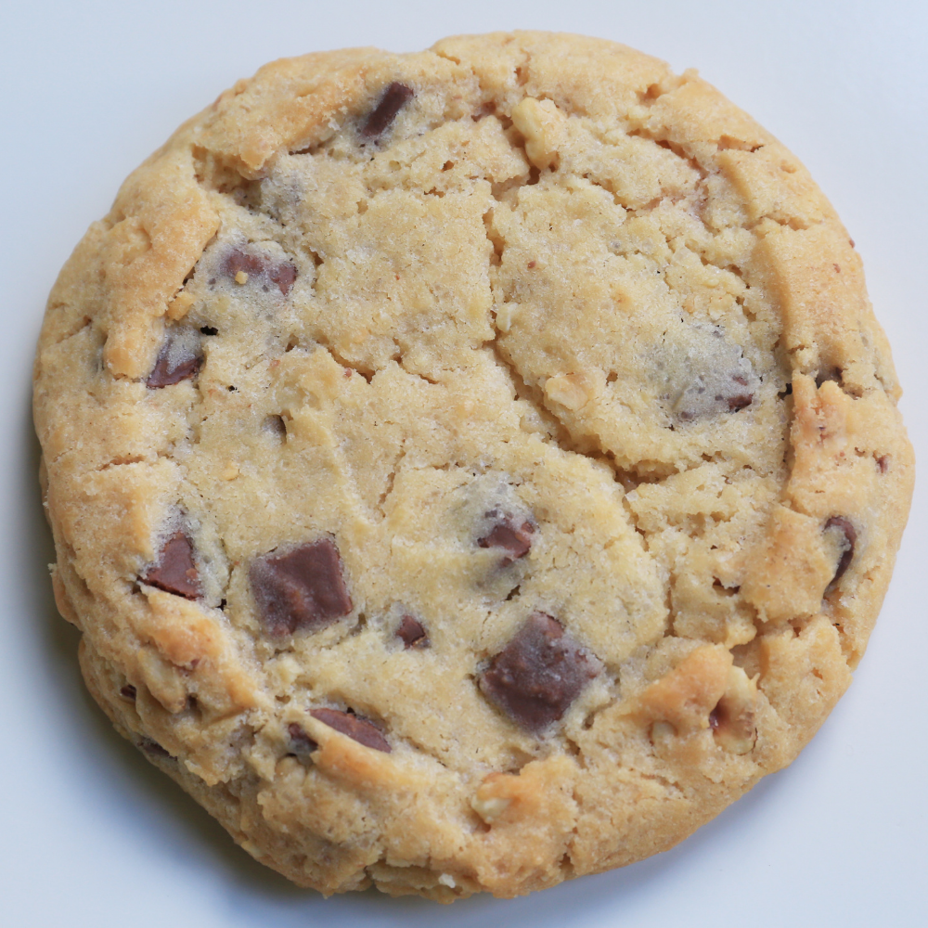
What has happened to the calories in the average cookie since the 1980’s?
a) Doubled
b) Tripled
c) Quadrupled
d) Stayed the same

Slide 39
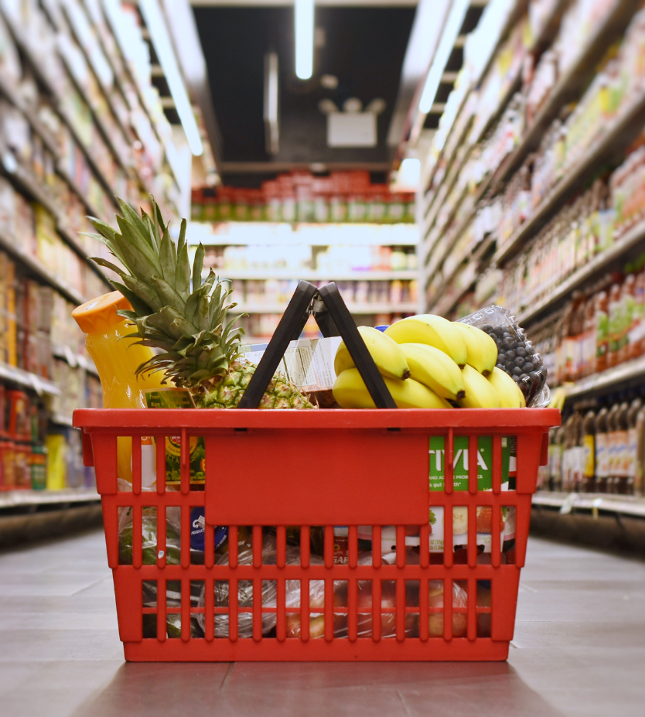
Which of the following is responsible for the most
wasted food?
a) Farms
b) Grocery stores
c) Restaurants
d) Households

Slide 40
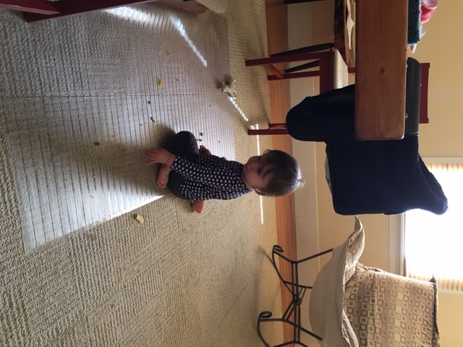
Let’s just say you’re
concerned about this
whole food waste thing –
what could you do?
a) Something

Slide 41
Working to Reduce
Food Loss and Waste

Slide 42
Impacts of Uneaten Food: Hunger & Food Insecurity
A Blueprint for Action
7
ReFED outlined seven key action areas for the food system to focus its efforts over the next ten years to prevent, rescue, and recycle food at risk of going to waste.

Slide 43
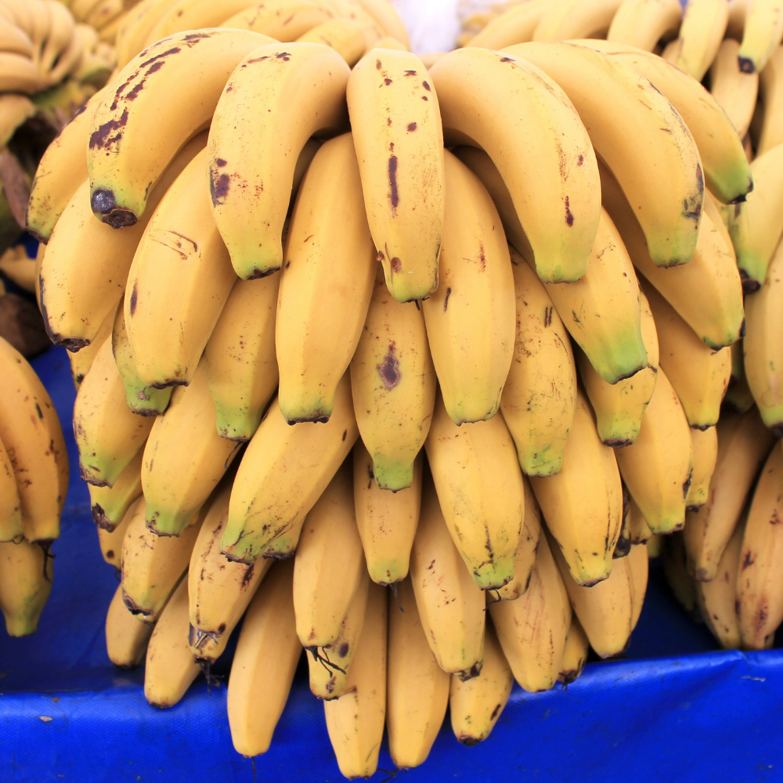
“Optimize the harvest” means aligning what is grown with what is ultimately harvested, by avoiding overproduction and then harvesting as much as possible. For wild-caught products, it means sourcing only what is needed.

Slide 44
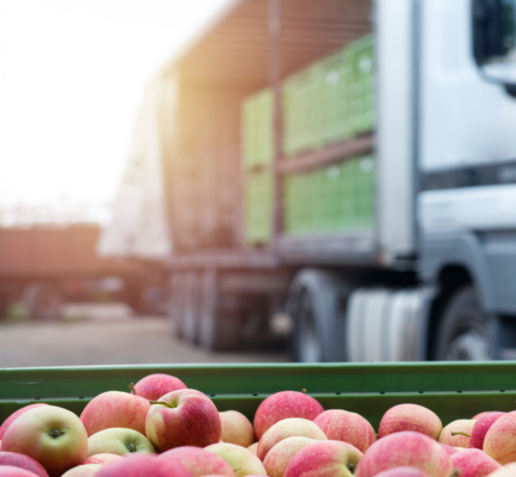
“Enhance product distribution” means maximizing freshness and selling time by harnessing the power of technology to create smart systems to efficiently move products.

Slide 45
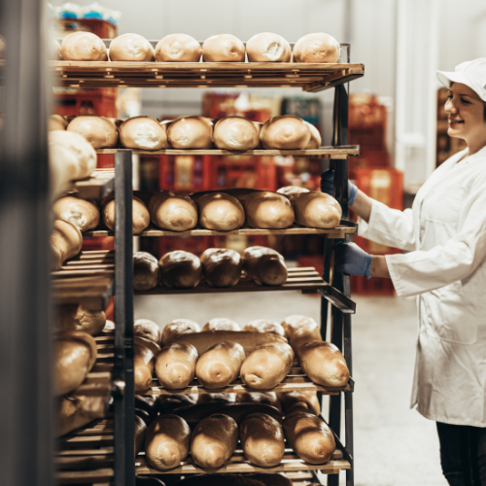
“Refine product management” means aligning purchases with sales as closely as possible – and when surplus arises, finding secondary outlets to accommodate it. It also means building out systems and processes for optimal on-site handling.

Slide 46
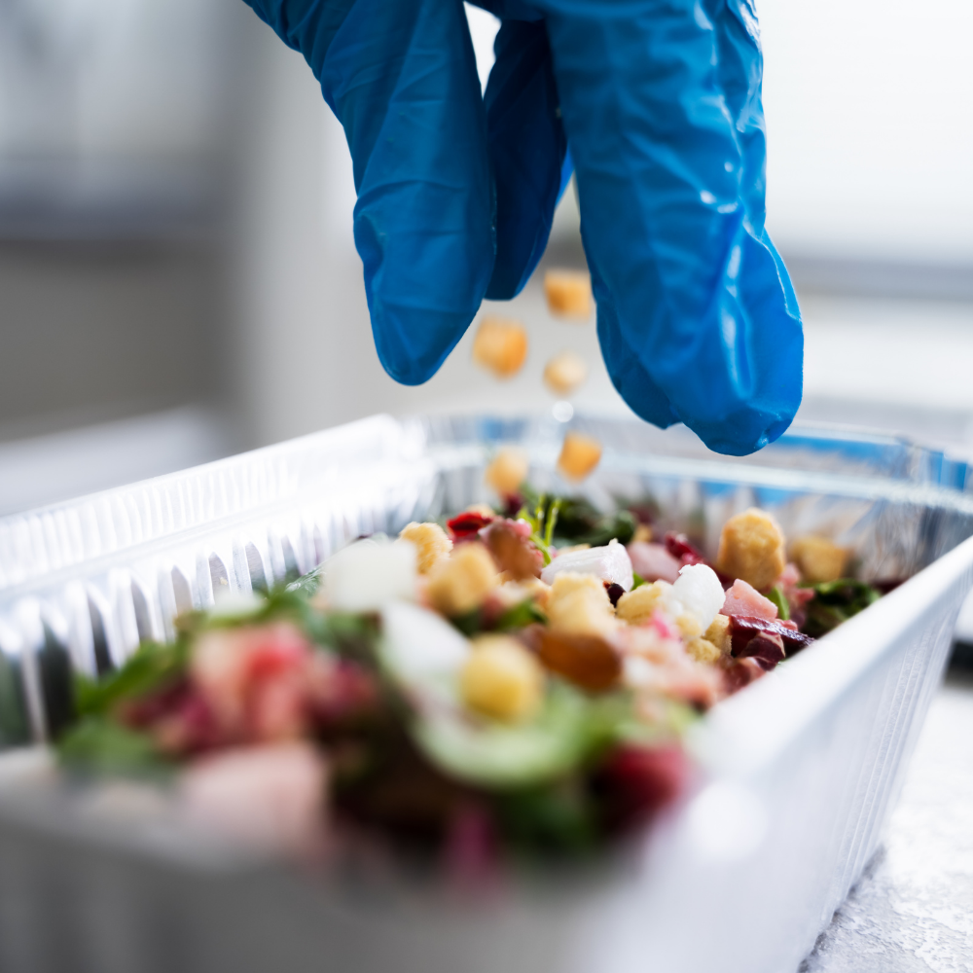
“Maximize product utilization” means designing facilities, operations, and menus to use as much of each product as possible. It also means rethinking the concept of “waste” by turning surplus and byproducts into food products through upcycling.

Slide 47
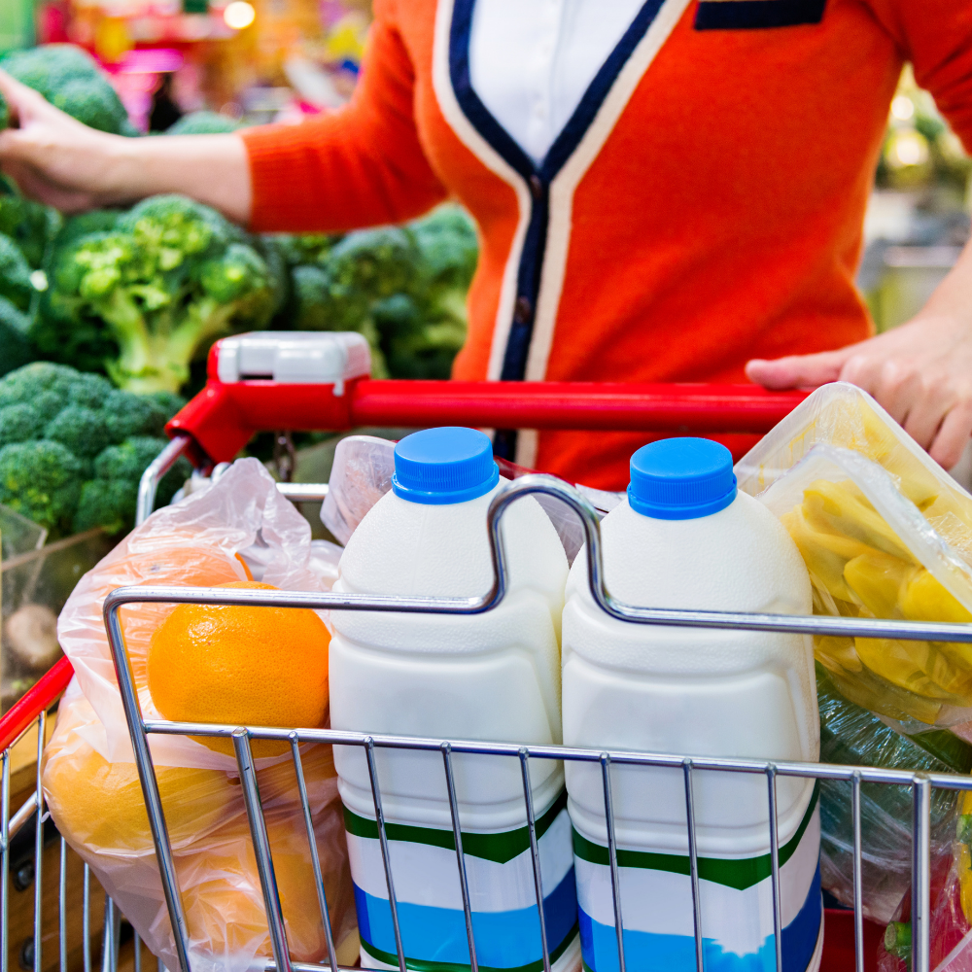
“Reshape consumer environments” means driving consumers toward better food management and less waste by creating shopping, cooking, and eating environments that promote those behaviors.
Notes:
Further the rescue of high-quality, nutritious food by increasing capacity, addressing bottlenecks, and improving communication flow.

Slide 48
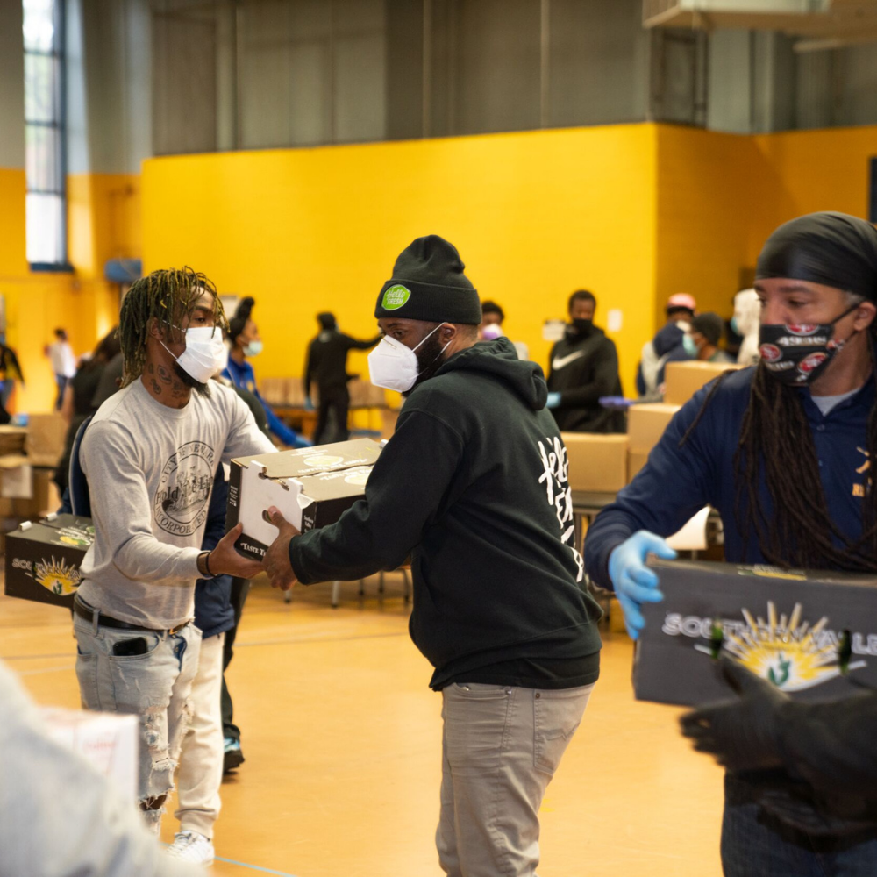
“Strengthen food rescue” means furthering the rescue of high-quality, nutritious food by increasing the capacity of food relief agencies, addressing distribution bottlenecks, and improving communication flow.
Notes:
Further the rescue of high-quality, nutritious food by increasing capacity, addressing bottlenecks, and improving communication flow.

Slide 49
“Recycle anything remaining” means capturing nutrients, energy, or other residual value by finding the highest and best use for any food or food scraps that remain.
Notes:
Further the rescue of high-quality, nutritious food by increasing capacity, addressing bottlenecks, and improving communication flow.

Slide 50
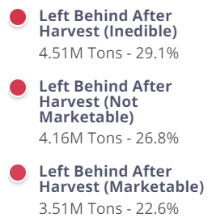
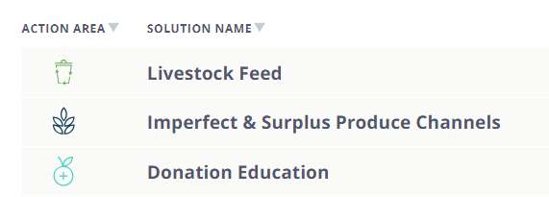
TOP CAUSES
TOP SOLUTIONS

Slide 51
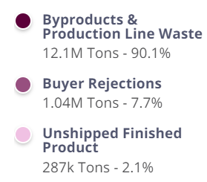
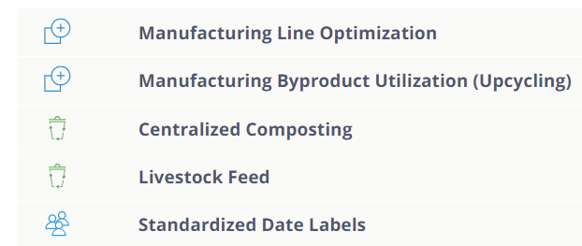
TOP CAUSES
TOP SOLUTIONS

Slide 52
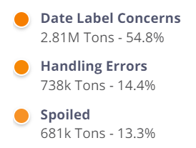
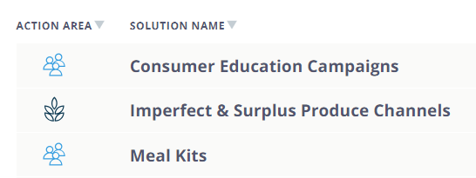
TOP CAUSES
TOP SOLUTIONS

Slide 53
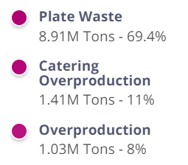
TOP CAUSES
TOP SOLUTIONS

Slide 54
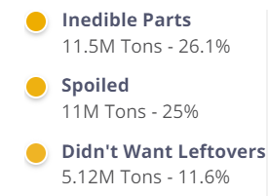
CONSUMERS
TOP CAUSES
“Food Waste Five” Solutions
Plan Your Meals
Store Food Properly
Learn Your Labels
Freeze, Freeze, Freeze
Eat Down What You Have
Many more tips at:
savethefood.com

Slide 55
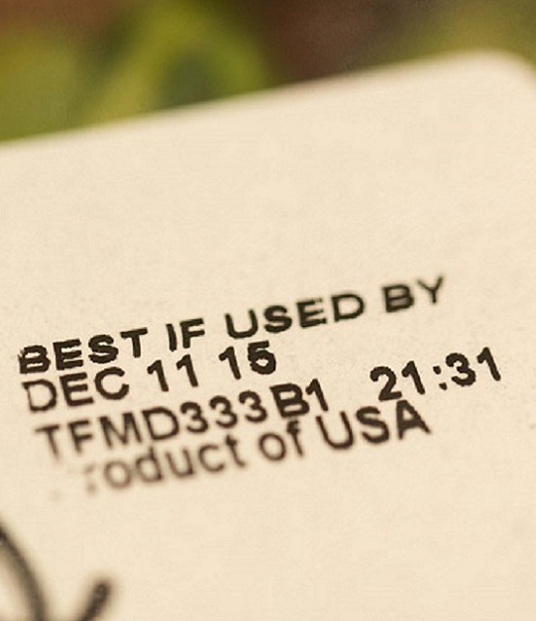
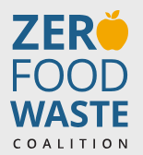
Date Labels
Date label confusion is one of the leading causes of consumer food waste, estimated to drive nearly 85% of Americans to prematurely toss food that is still safe to eat.
Recent voluntary initiatives in the US have coalesced around the standard labels “Best If Used By” for food’s peak quality and “Use By” for food safety.
Bipartisan Food Date Labeling Act is introduced to Congress almost every year to codify a national standard. The bill would clarify that food can be safely donated past the “BEST If Used By” date. The bill also critically requires FDA and USDA to educate consumers about the meaning of these date-label terms.
Stephen Gosling Photography
Resources:
https://zerofoodwastecoalition.org/
Notes:
7.5% of residential surplus and 55% of retail surplus in 2021 was due to date label concerns.
Image Copyright: © Stephen Gosling Photography

Slide 56
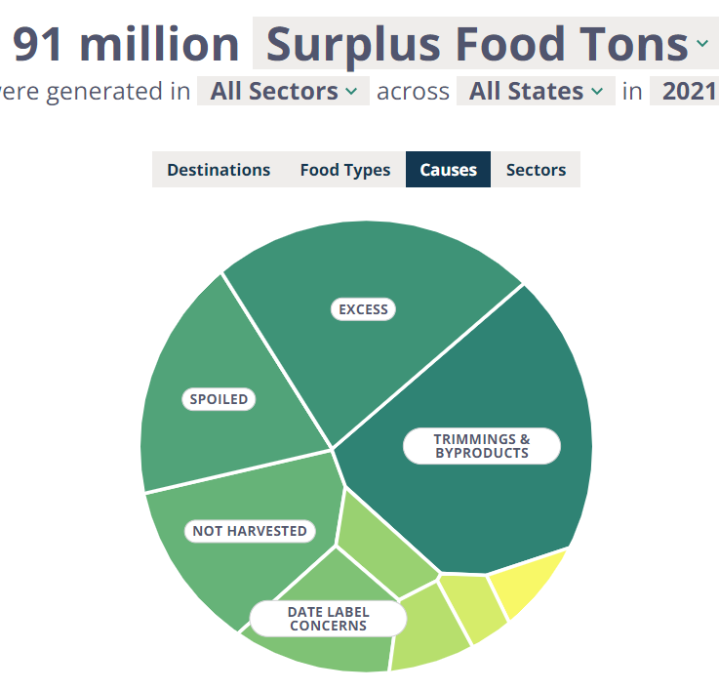
Donating Food
Just 2% of annual food surplus gets donated; the remaining surplus represents 149 billion meals’ worth of food.
22% of food surplus is inedible parts such as bones and peels. An additional 33% is “not fit for human consumption” - but could potentially be edible with better food management practices. That leaves 45% that’s currently “fit to eat”.
The Bill Emerson Good Samaritan Food Donation Act of 1996 provides limited liability protection for people who make good faith donations of food and grocery products to nonprofits that feed the hungry. (Local and state laws may also provide immunity from civil liability regarding food donation operations.)
Resources:
https://www.nycfoodpolicy.org/expiration-dates-can-you-donate-past-date-packaged-foods/
https://us.sodexo.com/files/live/sites/com-us/files/inspired-thinking/2023/Sodexo_Food_Recovery_Donation_Guide.pdf?ct=t(EMAIL_CAMPAIGN_6_29_2023_14_20)&mc_cid=f3e9575d83&mc_eid=0e5c1769de
Notes:
“Not fit for consumption” = inedible parts PLUS food that’s moldy, food wasted due to food safety concerns, food ruined due to cooking issues, etc

Slide 57
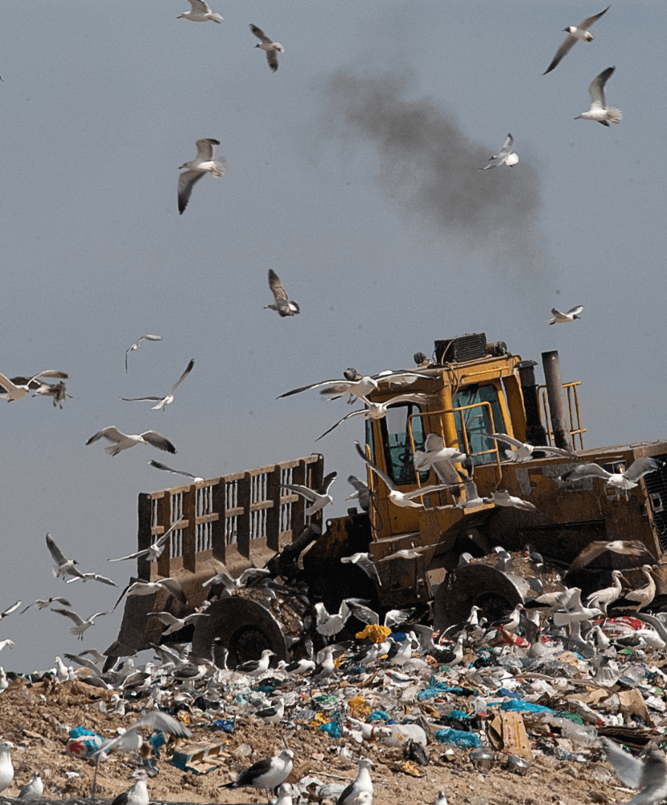
Landfill Methane
Methane is generated when organic matter (food, yard trimmings, etc.) decomposes under anaerobic conditions.
Methane is a powerful greenhouse gas – 80 times more potent than carbon dioxide on a 20-year time frame. However, methane has a relatively short residence time in the atmosphere - it breaks down after about 12 years on average. Therefore, targeting methane sources now will reduce atmospheric GHG concentrations with effects that will be felt in just a decade or two - which is critical for limiting warming by 2050.
EPA research indicates that diverting food waste from landfill reduces the methane generation potential by 33%.

Slide 58
Composting
Home Composting
Community Composting
Centralized “Composting”
https://lomi.com/
https://www.lakesrpc.org/ckfinder/userfiles/files/Centralized%20Composting_full%20doc_.pdf
http://whitelockfarm.org/compost
https://www.insidehook.com/article/advice/how-to-compost

Slide 59
The ReFED Insights Engine
An interactive knowledge hub for food loss and waste launched in 2021, the Insights Engine lets users:
1. Understand the Problem
2. Explore the Solutions
3. Find Solution Providers
4. Calculate Impact
5. Track Capital
6. Review Policies

Slide 60
https://refed.org/

