Slide 1
On Becoming Free from Plastic Pollution
Overture to the 226th General Assembly (2024)

Slide 2
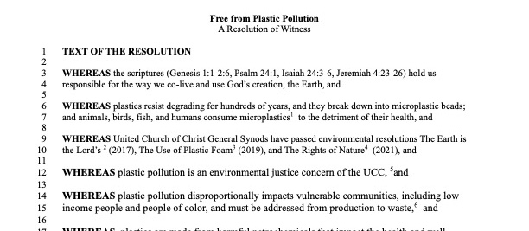
On Becoming Free from Plastic Pollution
Resolution of Witness passed by 2023 United Church of Christ General Synod
(Equivalent to our General Assembly)

Slide 3
On Becoming Free from Plastic Pollution
Top Level Recommendations (1)
Encourage all our settings to commit to changing from a disposable culture to a reusable, sustainable one.
Encourage education within our congregations and in our communities to advocate for alternatives to single use plastics, whether through mitigation efforts and campaigns or by supporting local and state bans on single use plastics, and
Encourage all settings of the Church to determine the best pathway forward for strategies and actions to mitigate plastic pollution, using as examples the following resources: …

Slide 4
On Becoming Free from Plastic Pollution
Top Level Recommendations (2)
Reduce the use of single-use plastics and packaging.
Commend all settings of the church to join in possible opportunities for participation in addressing plastic pollution including to: …
Acknowledge that accommodations in expectations need to be made for certain impacted groups such as those who are disabled or unhoused.
Encourage people in all settings to speak truth to the public square against plastic pollution of our planet.

Slide 5
On Becoming Free from Plastic Pollution
Rationale (1) Background
The 222nd General Assembly overwhelmingly agreed that “caring for God’s creation” should be part of our constitution
In 2023, our sisters and brothers in the UCC General Synod passed the overture “Free from Plastic Pollution: A Resolution of Witness”. We overture the 226th General Assembly to join them
The PC(USA) General Assembly has affirmed that creation care is a fundamental part of who we are as Presbyterians:
In Genesis 2:15, God places Adam in the garden “to serve it and to preserve it” (Dr. William P. Brown, Columbia Theological Seminary)

Slide 6
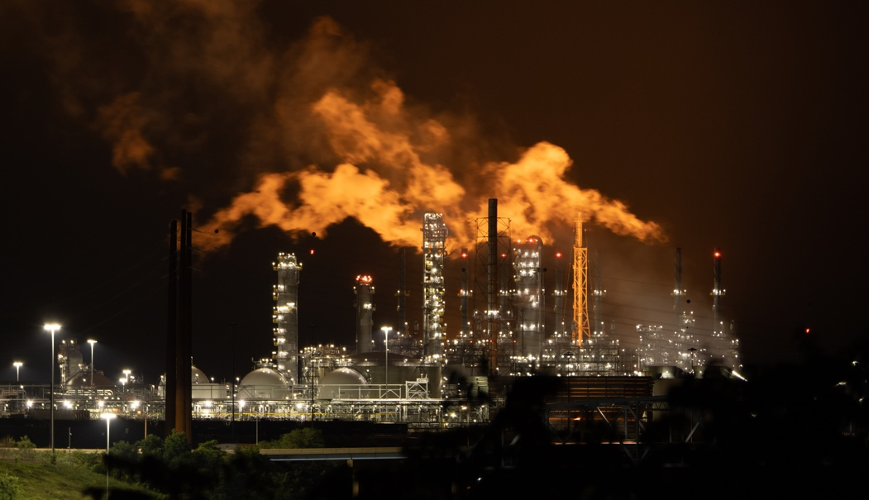
Rationale (2) God’s People Cry Out
Water from disposable water bottles contains about 240,000 nanoparticles per liter.
Plastics in our bodies can have serious impacts on our health and inhaled plastics have been correlated with lung inflammation, shortness of breath and a higher risk of lung cancer.
These impacts disproportionately fall on vulnerable and disadvantaged communities.

Slide 7
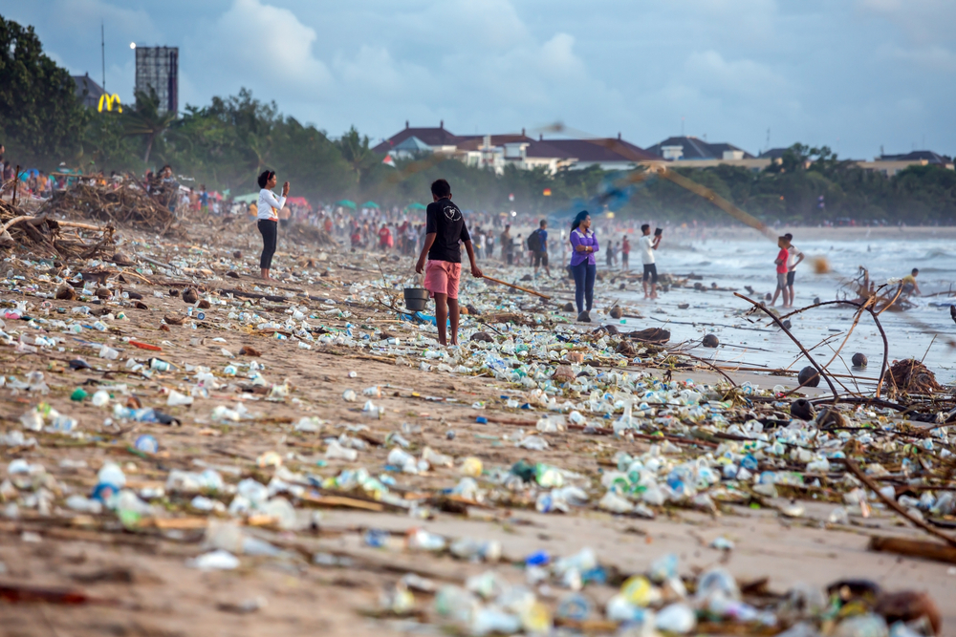
Rationale (3) The Earth Cries Out
430 million tons of plastic is produced yearly
11 billion metric tons of plastic produced in the last century, surpassing the biomass of all animals on earth.
Think that your plastic is being recycled? Think again. Despite efforts to convince people recycling is effective, only 9% of the plastic ever produced has been recycled, and 19% has been incinerated.

Slide 8
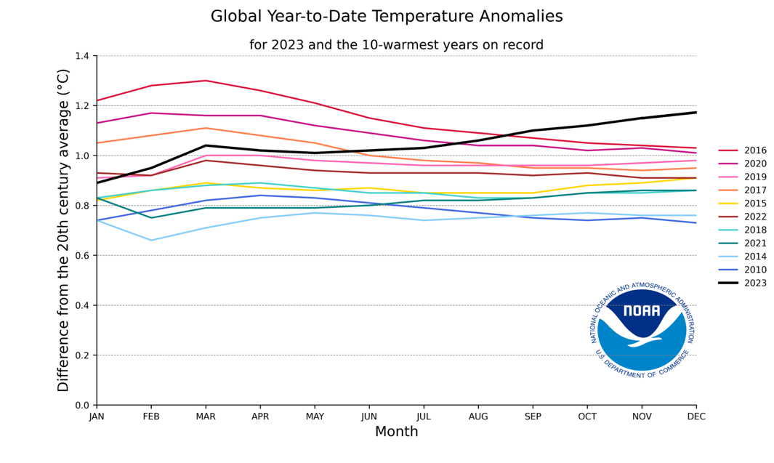
2023
Rationale (4) The Climate Cries Out
~ 99% of plastic comes from fossil fuels, generating 3.4% of global greenhouse gas emissions
Petrochemical companies have undertaken a massive increase in plastic production referred to as “Plan B for the fossil fuel industry” to expand use of plastics and increase demand for fracked gas and work to weaken legislation and international treaties.
Leaked methane, has 28 times more impact on warming the climate than CO₂ and is responsible for ~ 30% of the rise in global temperatures
2023 was the warmest year on record, by far.

Slide 9
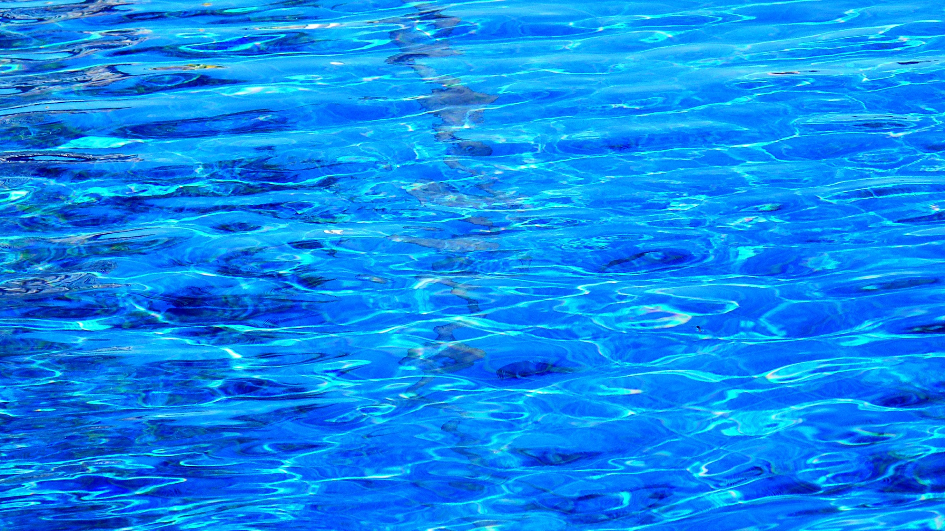
God placed Adam in
the garden to serve it
and to preserve it.
It is time for the Presbyterian Church (USA) to preserve creation by becoming free from plastic pollution.

