Slide 1
Overture Presentation moderated by Rev. Bruce Gillette
OOO
M

Slide 2
“removal of investments in and subsidies for fossil fuels”
Introduction by Rev Fred Milligan
Explanation of each ask and its rationale by Pam McVety
Questions/Answers and Discussion

Slide 3
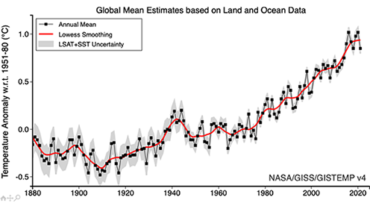
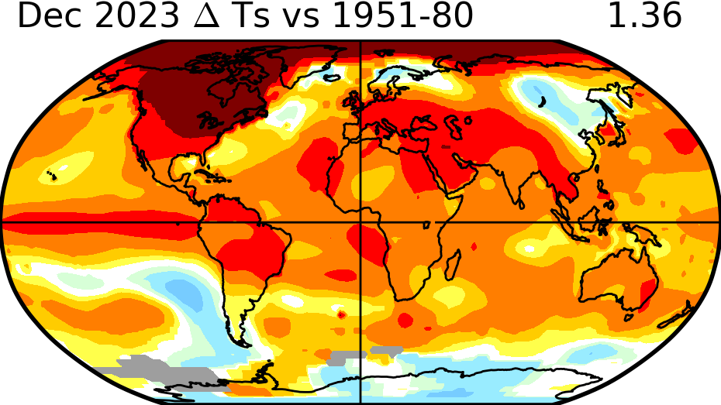
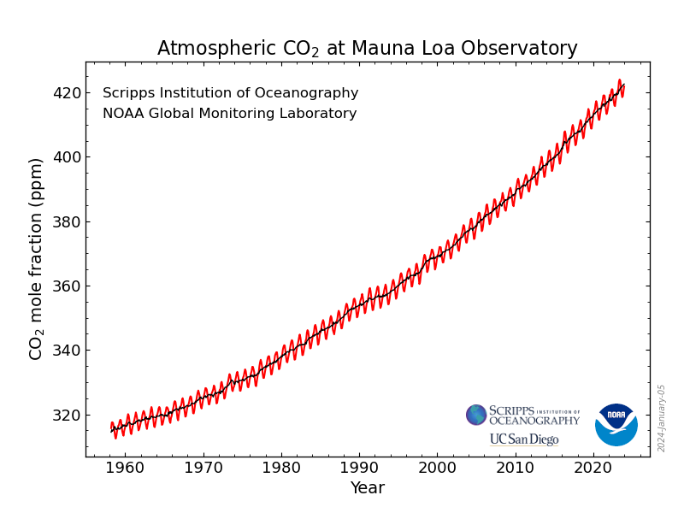
We are in the midst of a climate Crisis
Temperatures are following carbon dioxide
emissions
The world is getting hotter
Carbon dioxide emissions are going up
Notes:
Here is the science. Our carbon emissions are going up. Temperatures are following and the world is setting getting not just warm, it is getting hotter. Records are being broken year after year.

Slide 4
FROM WARMING TO BOILING
As UN General Secretary Antonio Guterres said on July 27 of last Year: “Climate change is here, it is terrifying, and it is just the beginning. The era of global warming has ended; the era of global boiling has arrived. The air is unbreathable, the heat is unbearable, and the level of fossil fuel profits and climate inaction is unacceptable. Leaders must lead. No more hesitancy, no more excuses, no more waiting for others to move first. There is simply no more time for that.”

Slide 5
God’s creation is Suffering 2023 Set a record with 28 weather and climate disasters costing at least 1 billion dollars Each.
Notes:
This is just the US. Disasters are happening all over the planet and getting worse. People are losing their homes. Prolonged droughts are causing thousands to migrate north from central America to the US. Birds are disappearing. People are dying. Insurance rates are unaffordable in Florida. We are leaving our children with an unsafe future.

Slide 6
Sources of Carbon Dioxide in Atmosphere*
Notes:
Source: IPCC (2014) Exit based on global emissions from 2010. Details about the sources included in these estimates can be found in the Contribution of Working Group III to the Fifth Assessment Report of the Intergovernmental Panel on Climate

Slide 7
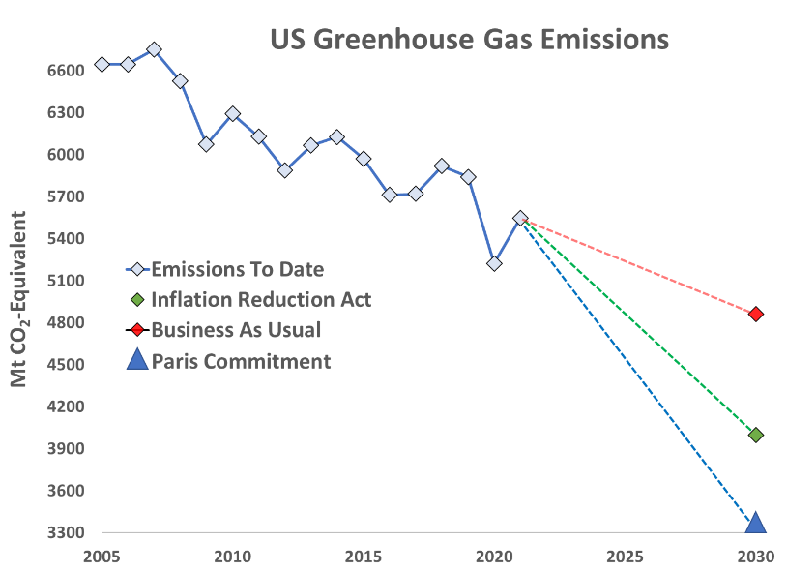
A full implementation of the IRA will only get us to between 30-40% reduction by 2030
27% cut
40% cut
Sources: EPA GHG emissions inventory, Rhodium, Energy Innovation, and Princeton REPEAT
50% cut
Notes:
Models show that our current policies don’t get us where we need to go
If you look at this graph, the red line shows the path we were on before the Inflation Reduction Act passed--we would reduce our emissions by about 27% by 2030. With the IRA (the green line) models suggest we could reach a 40% reduction.
The Paris Agreement and IPCC target is for 50% by 2030. And then we need to continue to work to get to net zero by 2050.
And these policies primarily affect just US emissions. What about the rest of the world? Climate change is a global issue.
So how do we bridge that gap? Economists, the UN, modelers, and scores of others support a policy mechanism with three parts (1)carbon pollution fee, (2) with a rebate/cashback, and (3) a border adjustment as a key strategy in closing the gap. [optional- Lynn added red to help make this clear for audience]

Slide 8
Since 2014 Presbyteries have sent numerous overtures requesting removal of denominational funds from the Fossil fuel industry
In response to these requests, the G.A.’s Mission Responsibility Through Investment (MRTI) entity brought a list of 5 companies to the 2022 Assembly which were approved by the commissioners.
Afterwards, the Board of Pensions and the Presbyterian Foundation removed their funding from five of the worse fossil fuel companies.
BUT, they reinvested in OTHER fossil fuel companies!

Slide 9
We have a way forward
Our denomination has repeatedly acknowledged all the suffering and disasters caused by the climate crisis, as well as our biblical mandate to address it. But MRTI’s approach is only designed for company by company engagement on the assumption that the fundamental activity of the company is worthwhile.
After careful consideration of our past experiences with this process and consultation with MRTI, we are calling for the entire industry to be placed on the denomination’s prohibited securities list.

Slide 10
Explanation: Overture on Removal of Investments in and Subsidies for Fossil Fuels
Pam McVety
Elder First Presbyterian Church Tallahassee
Florida Presbytery
January 24, 2024

Slide 11
Overture summary in three Sentences
Fossil Fuels should be Prohibited Investments: Calls for Presbyterian entities to quickly remove the entirety of their financial investments from the fossil fuel industry using a 1984 divestment strategy that says that certain industries are incompatible with our Christian values and should be prohibited investments.
Fossil Fuels are Incompatible with Our Faith Teachings: It is a reminder that we are called to follow Jesus’s teachings to love our neighbors and care for creation and that our continued financial support of the fossil fuel industry whose products are destroying the livability of the planet is not compatible with this.
Shift to Renewable Energy: And that we can change our focus to do more to promote a cheaper, safer and healthier future that is free of fossil fuels, by shifting our investments to renewable energy.

Slide 12
Reader’s Digest Version of the Overture
There are six asks in this overture and a rationale.
This is a summary of each.
You are encouraged to read the entire overture.

Slide 13
First Ask
Ask: The denomination is asked to declare that continued support of the fossil fuel industry with the PCUSA’s investments violates the rights of all living things to exist and our biblical charge to care for creation and is irretrievably incompatible with the mission and goals of the Presbyterian Church.
Rationale: Funding an industry that is destroying God’s creation is in direct conflict with all three statements above – the right of all living things to exist, our biblical charge to care for God’s creation and the mission and goals of the Presbyterian church to follow the teachings of Jesus Christ to love our neighbors and to take care of the least of these.
Notes:
This is a call for our denomination to lead the fight against climate change by removing our financial support from this industry. Climate change is real. It is happening now and the breadth of its destruction is terrifying. To continue to fund it is immoral.

Slide 14
Second Ask
Ask: The overture asks for a declaration that all publicly traded companies whose primary source of income is from the exploration, development and production of fossil fuels are to be placed on the GA’s list of prohibited securities.
Rationale: In 1984, the General Assembly approved a policy to list and exclude companies that are, because of their fundamental nature, irretrievably incompatible with the nature and purpose of the church. They are called prohibited securities. Fossil Fuel industry is such a company.

Slide 15
Third Ask
Ask: This identifies who is encouraged to align their investment decisions with this declaration with all due speed and diligence – All congregations, presbyteries, synods, the Board of Pensions and the Presbyterian Foundation, as well as individual church members and educational institutions.
Rationale: It is well understood that financial support from multiple institutions such as faith institutions, banks, insurance companies, universities and others keeps the fossil fuel industry in the business of producing fossil fuels. Doing this quickly is imperative as the impacts of our changing climate are happening faster and are more severe than predicted.

Slide 16
Fourth Ask
Ask: This asks these entities to seek out investments in clean renewable energy companies.
Rationale: Fossil fuels have served us well, but the world is now in the midst of the biggest transition it has ever experience in shifting to renewable energy. The costs of onshore wind and solar are are now the cheapest sources of energy on the planet and are safer, healthier and not subject to the price volatility or energy insecurity when conflicts breaks out like fossil fuels. Further they don’t have an existential down side the enormity of climate change.

Slide 17
Fifth Ask
Ask: This asks the Board of Pensions and the Presbyterian Foundation and other investing entities to report back at the next GA on the steps taken to align their investments with the intent of this overture.
Rationale: This is a simple reporting requirement, so we know the status of the denomination’s investments and whether any further action is required to align our investments with our values.

Slide 18
Sixth Ask
Ask: This asks the US government to end all subsidies to the fossil fuel industry.
Rationale: It is estimated that our government’s subsidies to this industry total $10-50 billion per year. We believe that our government should not subsiding the production of these emissions while it is spending billions to cut carbon emissions to address the climate crisis.

Slide 19
Questions and Discussion

